Slide 1

Child’s Plan Meetings

Slide 2

Aims:
Explain the function and purpose of Child’s Planning meetings
Understand the role and responsibility of the facilitator
Communicate and engage effectively with everyone involved in meetings
Structure and conduct Solution Oriented Child Planning meetings
Use a range of tools to get the most out of a meeting
Apply a range of strategies for handling different behaviours in meetings

Slide 3
What is a Child’s Planning Meeting/Discussion?
A Child’s Planning Meeting/ Discussion is one which takes place at any point in a child’s life with the aim of agreeing how the child, their family and professionals from any relevant organisation can work together to meet a child’s identified wellbeing need/s.

Slide 4
TASK
As Named Person/Lead Professional what steps need to take place before a meeting?

Slide 5
Things to think about and do before your meeting
Give people enough notice
Meeting times
Attendance issues
Reports and information
Consider any potential risks to the child or young person
Contentious meetings

Slide 6


Slide 7
Children and Young People should:
be fully informed about and prepared for the meetings.
attend meetings only with adults whom they already know.
be asked their preference for who attends a meeting.
have a choice in how they express their views in a meeting.
be given evidence of being listened to during a meeting.
always understand the language used during a meeting.
be involved in decision making during a meeting.
have their views recorded in the plan.
receive verbal feedback after a meeting and a copy of their plan

Slide 9
Making your Meeting about Finding Solutions
The Key Principles of a Solution Focused Approach

Slide 10
Process
Skills
Principles

Slide 11
Principles of Solution Oriented Practice
Principle 1: If it works, do more of it, if it doesn’t, do something different.
Examples: Learn from success. Ask “how did we do that?”. Notice the exceptions - the little things that are going well or are ok Stop and reflect. At what point we stop and acknowledge something isn’t working and needs to be done differently? Key distinction: exploit success vs. repeating failure.

Slide 12
Principles of Solution Oriented Practice
Principle 3: Language shapes and moulds how we make sense of the world.
Examples: Words ‘leak’ (e.g. ‘even’; use of ‘why?’; use of absolute terms such as ‘always’ & ‘never’) Being future oriented (e.g. use of ‘when’ not ‘if’) Key distinction: future possibilities vs. entrenched thoughts.

Slide 13
Principles of Solution Oriented Practice
Principle 2: The problem is the problem, not any person.
Examples: Take care with the language that is used. 2. Focus on the behaviour not the person. Key distinction: problem is external vs. internal, person-centred problem.

Slide 14
Principles of Solution Oriented Practice
Principle 4: Possibilities are infinite.
Examples: Be open to a wide range of possibilities – don’t be constrained by notions of ‘what should be done’ There is always something that can be done differently. Key distinction: receptive vs. closed.
Notes:
.

Slide 15
The Principles of Solution Oriented Practice
Principles of Solution Oriented Practice
Principle 5: Recognise strength, skill and resource in everything.
Examples: Notice people’s strengths and competencies. Recognise that people have the resources to change. Highlight those competencies to others in an explicit and genuine way Small changes lead to bigger changes Key distinction: encourage competence vs. correct weakness.

Slide 16
Time for Reflection…
Privately, and on a scale of 1-10, rate how good your solution oriented meetings are
In groups, and reflecting on the principles, think of the ways in which your meetings are already solution oriented. What would people see happening that would evidence that?
Think about what would need to happen would move you one point up on your original scale.

Slide 17
Feedback and questions

Slide 18
PROBLEM FOCUS – WHY? | SOLUTION FOCUS – WHAT? HOW?
Assessing problems – finding out details of what has gone wrong | Clarifying goals – what is going to be done to improve the situation
Examining past failures – finding to try out what happened, who was affected | Examining past success – what did you do to help you get through them?
Awareness of recent impairment – things have been a bit better but……. | Awareness of recent improvement – how did you manage to do that?
Explaining problems – why things happened? | Explaining progress – what did you do to make that happen? Who and what helped?
Pinpointing weaknesses and failures – where these were located? | Pinpointing strengths and resources – what is it about you that helped you through/ Who?
Blaming people who have been perceived as part of the problem | Acknowledging people perceived as having contributed to the solution

Slide 19
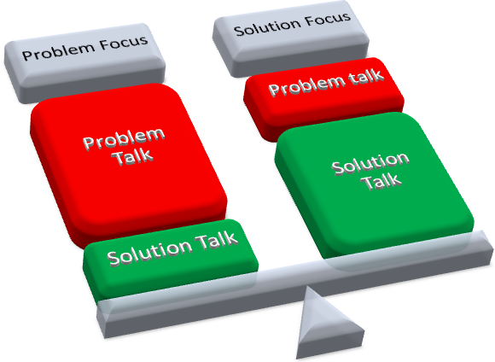
The Balance of Meetings

Slide 20
Facilitating a Child Plan Meeting
SECTION | USEFUL QUESTIONS | SKILLS NEEDED
Title and purpose(s) of the meeting
Issues/Concerns
What’s Going Well?
Outcomes /Goals
Actions
Review

Slide 21
“Off Track!!!”
ISSUE/PROBLEM | POSSIBLE STRATEGIES
If you have a speaker who is taking up too much time and not allowing others to contribute
Negativity/participants reluctant to move on
Group failing to move on
Someone making irrelevant statements
Barriers/blocks

Slide 22
After the Meeting
A continuous process
Everyone who is a partner to the plan should receive a copy of the Child’s Plan
Post meeting checklist

Slide 23


Slide 25
Children’s and Young People’s Views
Don’t put me on the spot
Don’t use big words
Don’t ask awkward questions in front of my Dad
Can I decide where everyone will sit?
Make the environment homely and relaxed
Dress down – wearing a suit is intimidating
Show that you are helping

Slide 26


