Slide 1



Slide 2


Information Sharing
In determining whether the information ought to be shared, the holder of the information is required to:
  obtain the views of the child or young person, so far as reasonably practicable and, in taking account of these views give consideration to their age and maturity; and
  consider whether, the likely benefit to the child or young person’s wellbeing of sharing information outweighs any likely adverse effect resulting from sharing information

Slide 3


ARTICLE 5 ARTICLE 12 ARTICLE 16

Slide 4
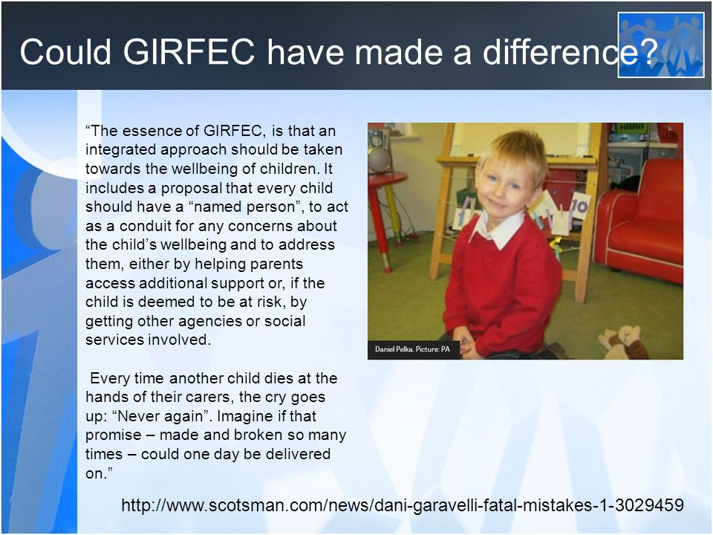

Slide 5

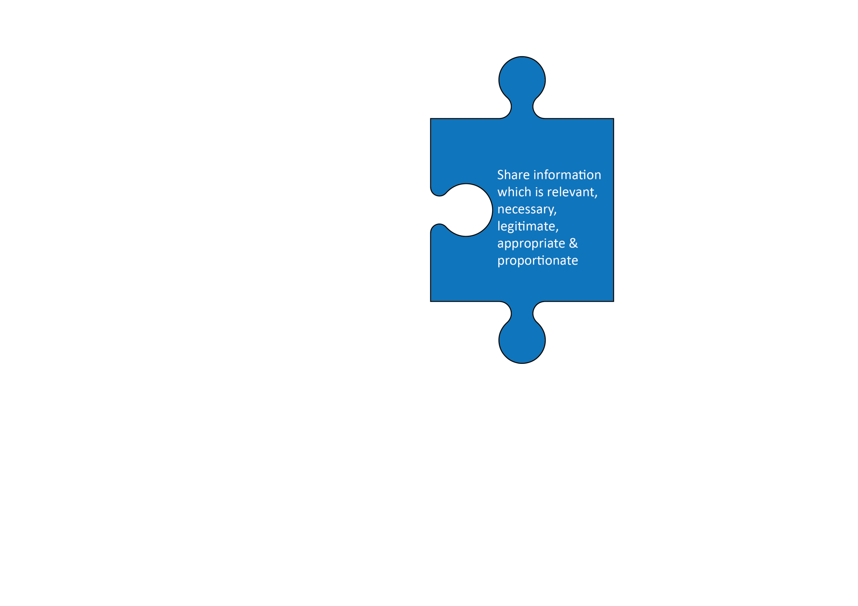
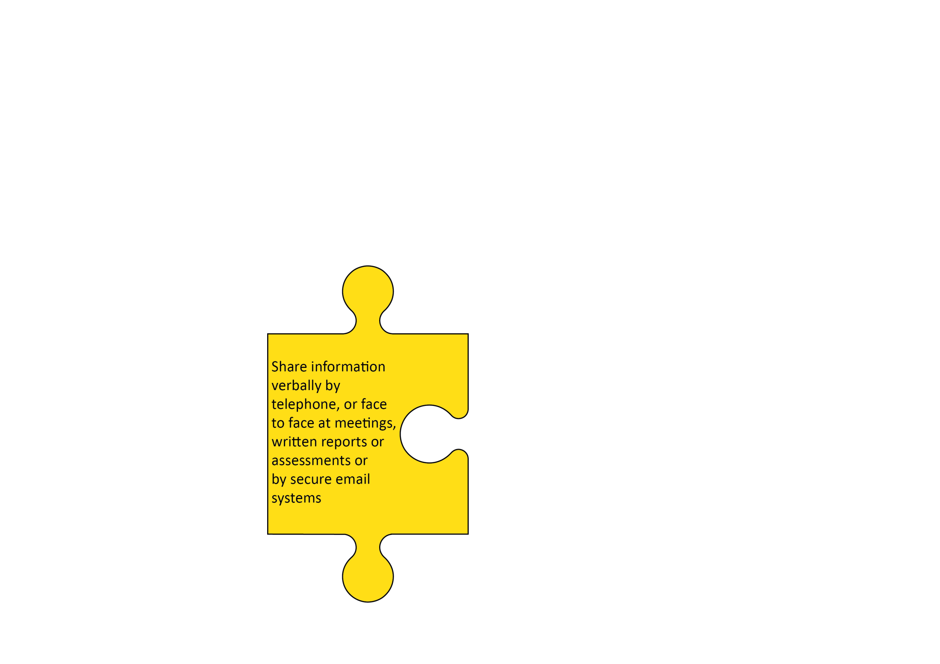





Short Guide to Information Sharing,
Confidentiality & Consent
Safe, Healthy, Achieving, Nurtured, Active, Respected, Responsible & Included
Relating only to your concern or worry – reduce or remove unnecessary data
1. When to share
2. What to share
4. How to share
3. Who to share with
Share information quickly efficiently effectively and securely
Discuss with Line Manager/Supervisor if you are unclear

Slide 6


Slide 7

CONSENT
Do not seek consent in situations where you will share information in any case - Consent should only be sought when the individual has a real choice over the matter
Consent should be informed and explicit - implied consent is not enough
If consent is necessary, children and young people subject to their age and developmental capacity, can withhold or provide consent
Consent must always be recorded

Slide 8
WOULD YOU SHARE?
Consent and Confidentiality
Case Studies

Slide 9
POINTS TO REMEMBER
    Record the reasons why you are sharing information and/or not sharing information
    Record with whom you have shared the information and when you did so
    Keep all information safe and secure at all times
    Always identify the person you are communicating with
    Do not give verbal information where you can be overheard
    Do not leave information on answering machines or voicemail
    Be aware of your service/agency's e-mail policy - always use secure e-mail; do not use fax

Slide 10

Practitioners Guide to Information Sharing, Confidentiality and Consent
To support Children and Young People’s Wellbeing.

