Slide 1

Universal Support/Targeted Intervention

Slide 2
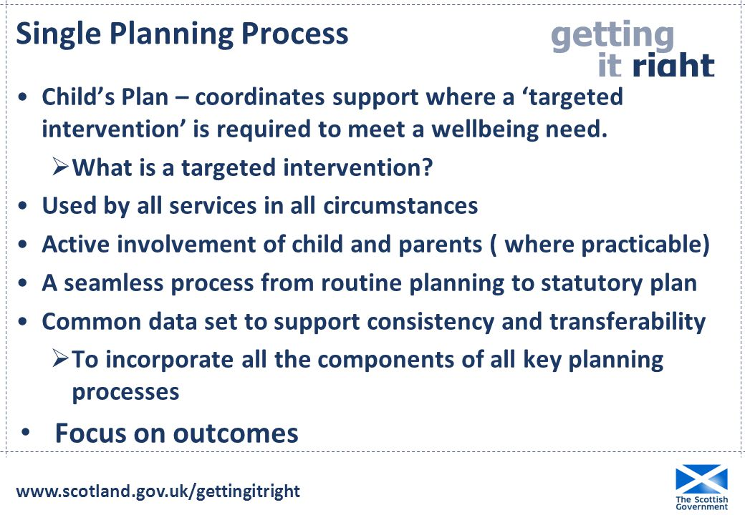

Slide 3
Moray Child Planning Pathway
Essentially 3 stages
    Universal
    Universal with support
    Targeted

Slide 4
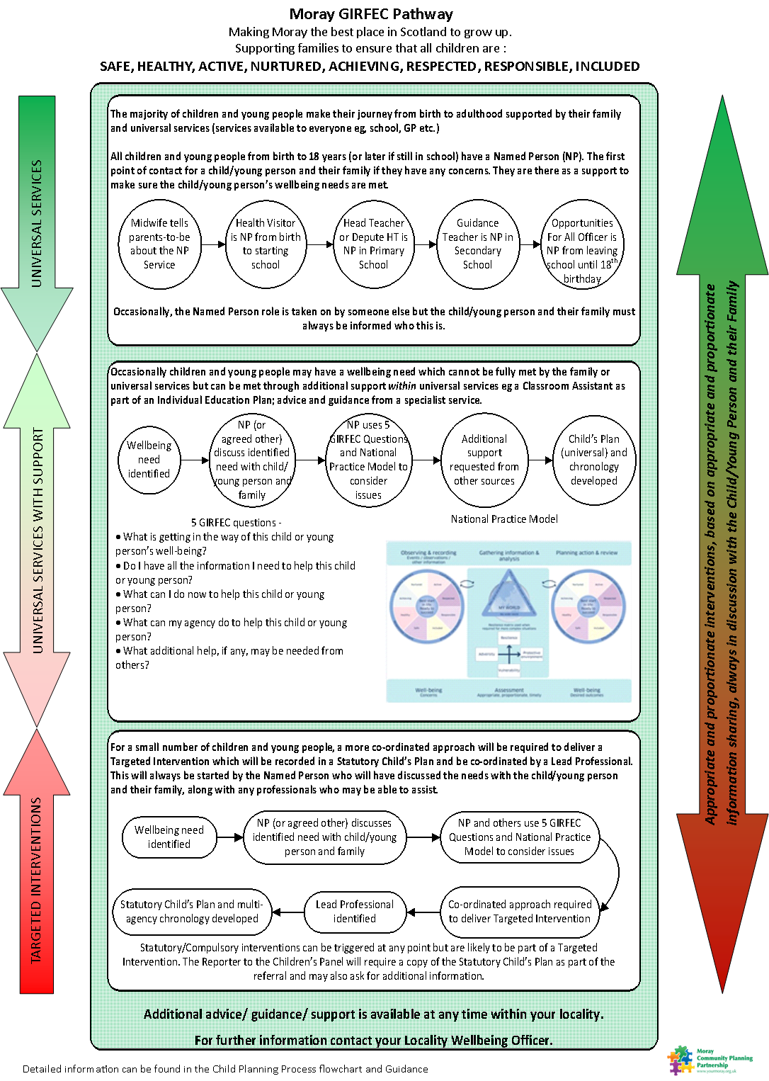

Slide 5
UNIVERSAL SERVICES

Slide 6
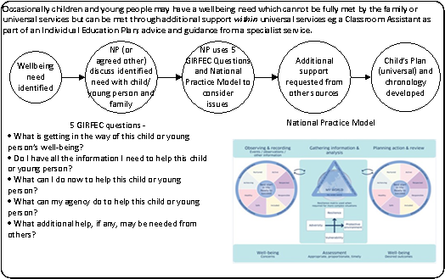
UNIVERSAL SERVICES WITH SUPPORT

Slide 7

TARGETED INTERVENTIONS

Slide 8
Statutory Intervention & Compulsory Measures
This response refers to situations where there is a statutory or compulsory role for Children and Families Social Work, which will be for a very small proportion of children/young people, for example:
Children subject to child protection procedures where Scottish Children’s Reporters Administration (SCRA) or the court requires a report.
The Social Worker will then usually take on the role of the Lead Professional, other than in exceptional circumstances.

Slide 10


The Smith Family

