Slide 1
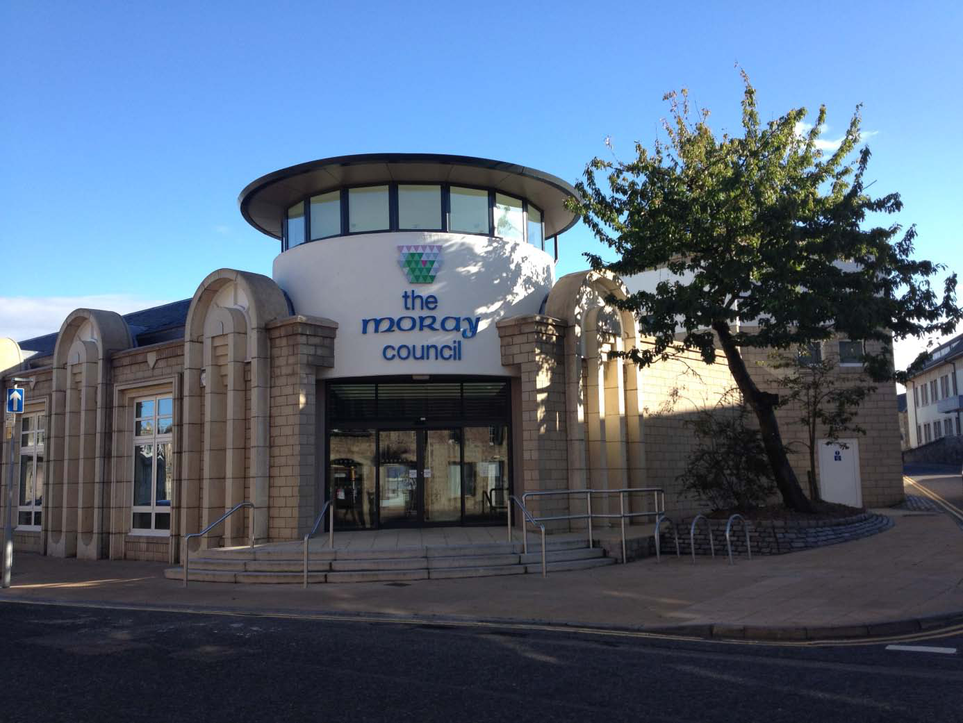
ANNEXE OFFICE CONVERSION

Slide 2
Heating Operation
Two gas fired boilers provide hot water to two separate circuits, a constant temperature circuit and a variable temperature circuit. The variable temperature circuit provides hot water to the trench heating in the open plan office and this is compensated against external ambient temperature.
The heating is designed to achieve a minimum of 19°C internal building temperature for early morning occupancy, when the external air temperature is no lower than minus 5°C. The BEMS learns from historical system operation and monitors external air temperature, then activates the boilers when required. The boilers are firing late Sunday evening on occasion to bring the building up to temperature on cold Monday mornings after the weekend closure
Localised thermostatic controls allow occupants to set the radiators output to their own local comfort level, but it should be kept in mind that valve settings equate to the following respective temperature outputs:
3 = 20°C, 4 = 23°C, 5 = 26°C and I = 28°C, when 21 to 22°C is considered a comfortable office environment
Turning thermostats up to max at the start of the week then off on Friday, will significantly inhibit heating performance, particularly after the heating has been off all weekend. Maintenance may choose to fit lockable heads on a standard setting in future

Slide 3
Building Temp Too Hot?
1. Check the heating is OFF to all areas. | • Check open plan space temperature • Check meeting rooms and training rooms temperature • Check over-door heaters are off
2. Open windows | All sides of the building to allow a flow of air throughout.
3. Open the ventilation turrets | Use the manual over-ride if these have not opened automatically (if external temp is over 12.5°C and internal temp is over 25.1°C).
 | Check the external air temperature recorded on the BEMS. The building is naturally ventilated and does not provide air conditioning throughout the occupied space. Due to the heating effect of occupants and equipment, it cannot reach a temperature lower than the external air temperature.
 | During extended periods of warm weather, ensure that the heating system is off by checking the automatic controls. The set-back temperature may also be reduced to minimize the overnight heat input.
 | If, despite these measures, the internal air temperature remains noticeably higher than the external then contact the help desk for assistance

Slide 4
Building Temp Too Cold?
1. Check the heating is ON to all areas and there is not a fault with the boilers operation | • Check open plan space temperature • Check meeting rooms and training rooms temperature
2. Close windows | All sides of the building to prevent draughts
3. Close the ventilation turrets and set the de-stratification fans to blow mode | Facilities staff to action via BEMS (turrets could only be open due to CO2 limit being exceeded in cold weather)
4. Check the radiator valves | Check that thermostatic valves are set correctly (not low or off)
5. Check over-door heaters | Ensure these are operating and set to the highest output mode
6. Check heating in training and meeting rooms | Ensure the thermostats are correctly set in all areas
7. General | Facilities staff to check the automatic control settings for the heating system to ensure that the overnight set-back is correct and that the target temperature/time parameters have been correctly adjusted.
 | If, despite these measures, the internal air temperature remains below an acceptable level, contact the help desk.

Slide 5
Staff Roles and Responsibilities
Can set the temperature output of radiators using local thermostats
Can open and close windows to allow natural ventilation, which design assumes will happen
Can set the thermostatic controls in training rooms and meeting rooms to comfort levels
Can open the wind turrets using short term localised control switches
Report issues using the Facilities online form

Slide 6
Facilities Roles and Responsibilities
Will control the BEMS settings for heating, ventilation and lighting operation
Will control the over door heat curtain settings
Will check any reported temperature concerns (high or low) and take necessary action in accordance with the trouble-shooting guide
Will control the lighting levels in the open plan area via the BEMS and make any essential adjustments required
Should inform the Property Maintenance help desk of unresolved problems for further investigation and instruction of repairs contractors as required

Slide 7
Property Maintenance Roles and Responsibilities
Will arrange regular servicing and repairs to all systems
Will assist Facilities staff to investigate any recurring problems with systems malfunction
Will provide advice on set-point levels in the BEMS and Summer/Winter adjustments in consultation with the Energy Officer

