Slide 1

Named Person Training

Slide 2
Notes:
S

Slide 4

AIMS:
As Named Person you have the required skills, knowledge and understanding required in the following areas:
    Information Sharing
    Wellbeing and the assessment of wellbeing
    Universal Support/Targeted Intervention/Statutory Compulsory Measures
    Child Planning Process
    Child Plan Meetings

Slide 5


PARKING LOT

Slide 6
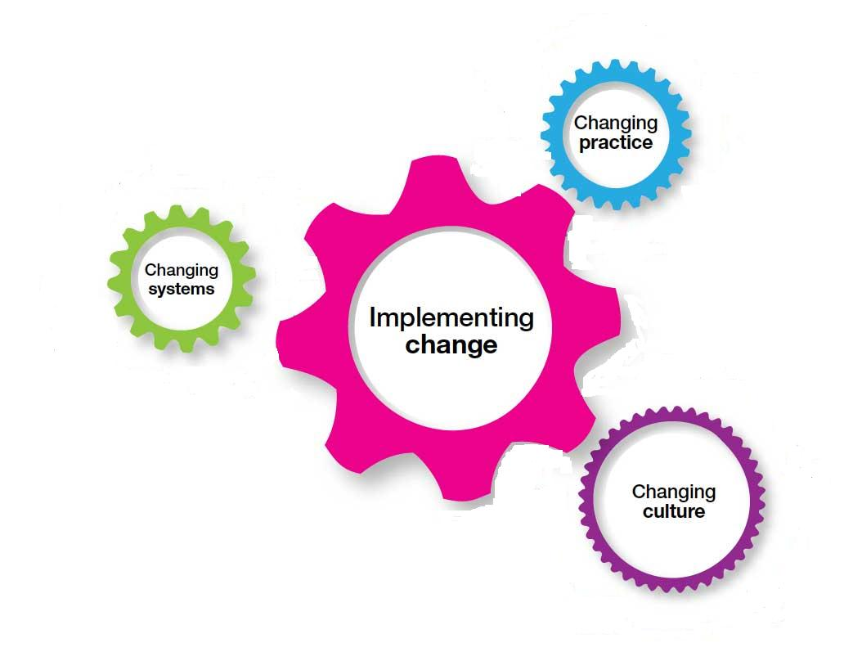

Slide 7
GIRFEC Core Components /Values and Principles
Getting it Right for every child is an approach
It is underpinned by ten core components and a set of values and principles which apply across all aspects of working with children and young people.
These values and principles are reflected in legislation, standards, procedures and professional expertise.
They are for everyone with a part to play in promoting the well-being of children and young people.

Slide 8

Laurence Findlay, Director of Education and Social Care

Slide 9


Slide 10

Named Person Service
birth – P1
P1 – age 18
Health Visitor
Education

Slide 11

Role of the Named Person
PROMOTE, SUPPORT and SAFEGUARD the wellbeing of the child or young person by:
    Advising, informing or supporting the child or the young person, or a parent of the child or young person
    Helping the child or young person, or a parent of the child or young person, to access a service or support
    Discussing, or raising, a matter about the child or young person with a service provider or relevant authority

Slide 12
Skills, Knowledge and Understanding

