Slide 1
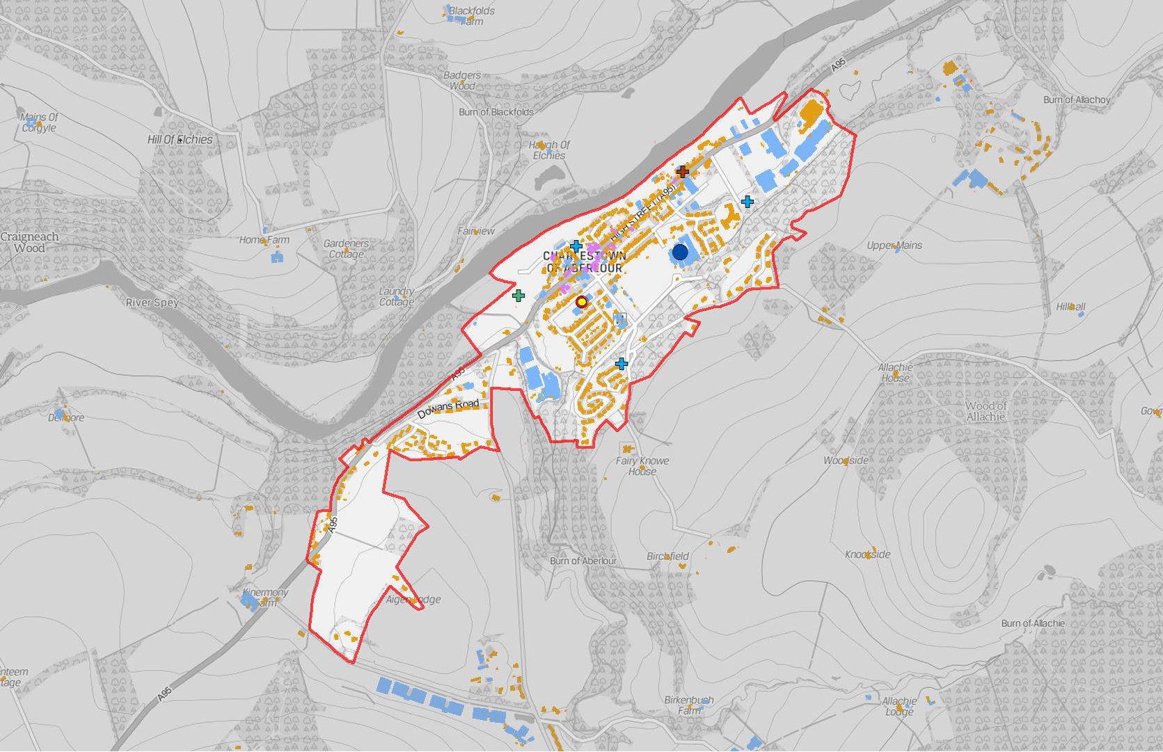

Legend
(! Nursery School
(! Primary School
!( Secondary School
GF Burial Ground GF Crematorium FG Funeral Parlour GF Mission Hall
GF Place Of Worship
Settlement Boundary
Building Use
Commercial Residential Mixed
Aberlour
-
1:15,000 @ A4
Reproduced from the Ordnance Survey map with the permission of the Controller of Her Majesty's Stationary Office Crown Copyright 2019 The Moray Council 100023422

Slide 2
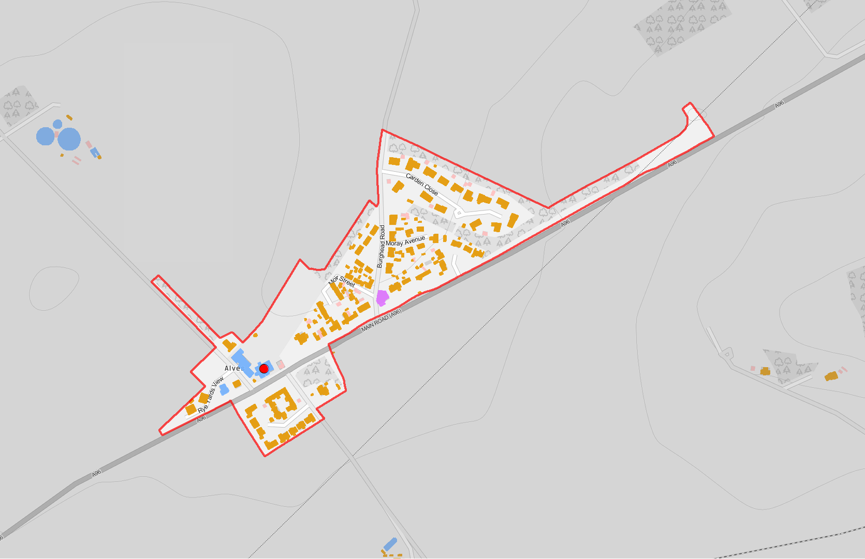
Legend
(! Nursery School
!( Primary School
!( Secondary School
FG Burial Ground FG Crematorium FG Funeral Parlour GF Mission Hall
GF Place Of Worship
Settlement Boundary
Building Use
Commercial Residential Mixed
Alves
-
1:5,000 @ A4
Reproduced from the Ordnance Survey map with the permission of the Controller of Her Majesty's Stationary Office Crown Copyright 2019 The Moray Council 100023422

Slide 3
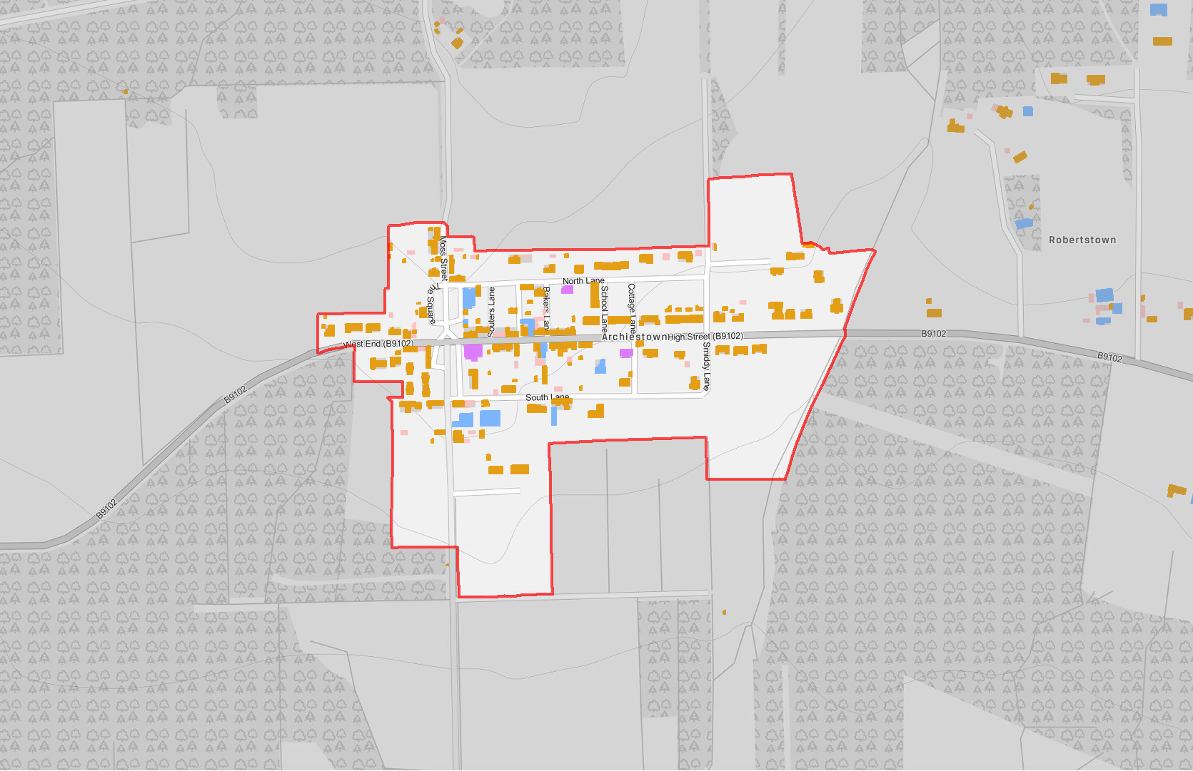
Legend
(! Nursery School
!( Primary School
!( Secondary School
GF Burial Ground GF Crematorium FG Funeral Parlour FG Mission Hall
FG Place Of Worship
Settlement Boundary
Building Use
Commercial Residential Mixed
Archiestown
Reproduced from the Ordnance Survey map with the permission of the Controller of Her Majesty's Stationary Office Crown Copyright 2019 The Moray Council 100023422
-
1:5,000 @ A4

Slide 4
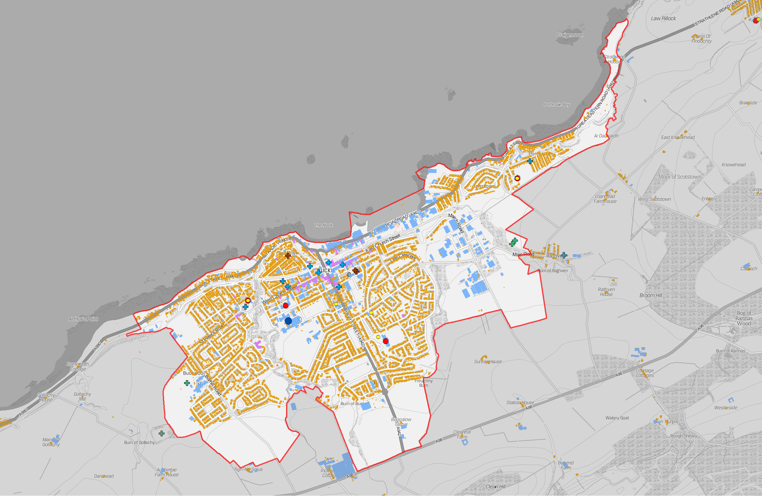

Legend
!( Nursery School
!( Primary School
(! Secondary School
GF Burial Ground FG Crematorium GF Funeral Parlour GF Mission Hall
GF Place Of Worship
Settlement Boundary
Building Use
Commercial Residential Mixed
Buckie - Building Use
-
1:15,000 @ A3
Reproduced from the Ordnance Survey map with the permission of the Controller of Her Majesty's Stationary Office Crown Copyright 2019 The Moray Council 100023422

Slide 5
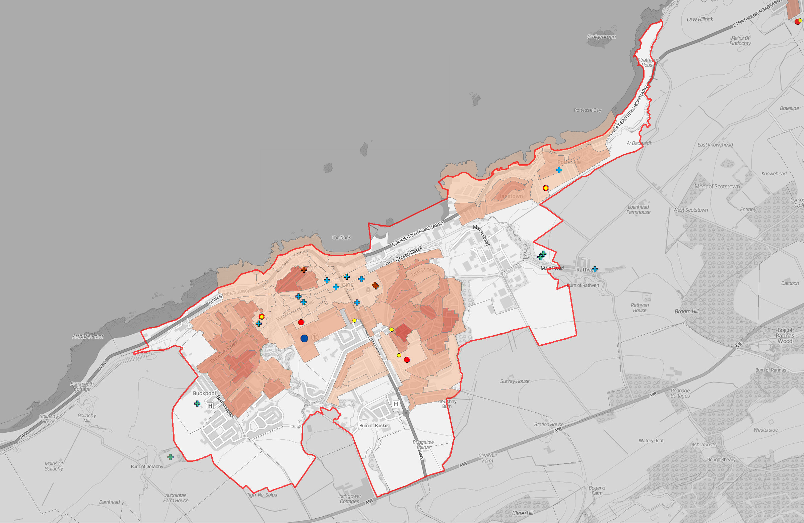
Legend
!( Nursery School
!( Primary School
!( Secondary School
FG Burial Ground GF Crematorium GF Funeral Parlour FG Mission Hall
GF Place Of Worship
Settlement Boundary
People per Hectare
0 - 14
15 - 29
30 - 44
45 - 74
75 - 99
100 - 199
200 - 306
Buckie - Population Density (Census Output Areas 2011)
-
1:15,000 @ A3
Reproduced from the Ordnance Survey map with the permission of the Controller of Her Majesty's Stationary Office Crown Copyright 2019 The Moray Council 100023422

Slide 6
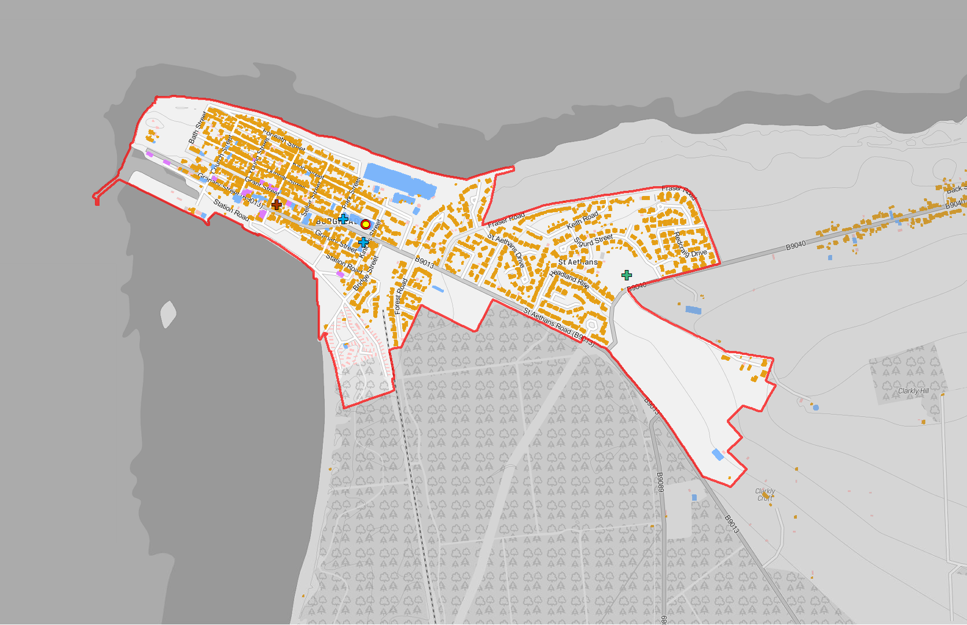
Legend
(! Nursery School
(! Primary School
!( Secondary School
GF Burial Ground GF Crematorium FG Funeral Parlour GF Mission Hall
GF Place Of Worship
Settlement Boundary
Building Use
Commercial Residential Mixed
Burghead
-
1:10,000 @ A4
Reproduced from the Ordnance Survey map with the permission of the Controller of Her Majesty's Stationary Office Crown Copyright 2019 The Moray Council 100023422

Slide 7
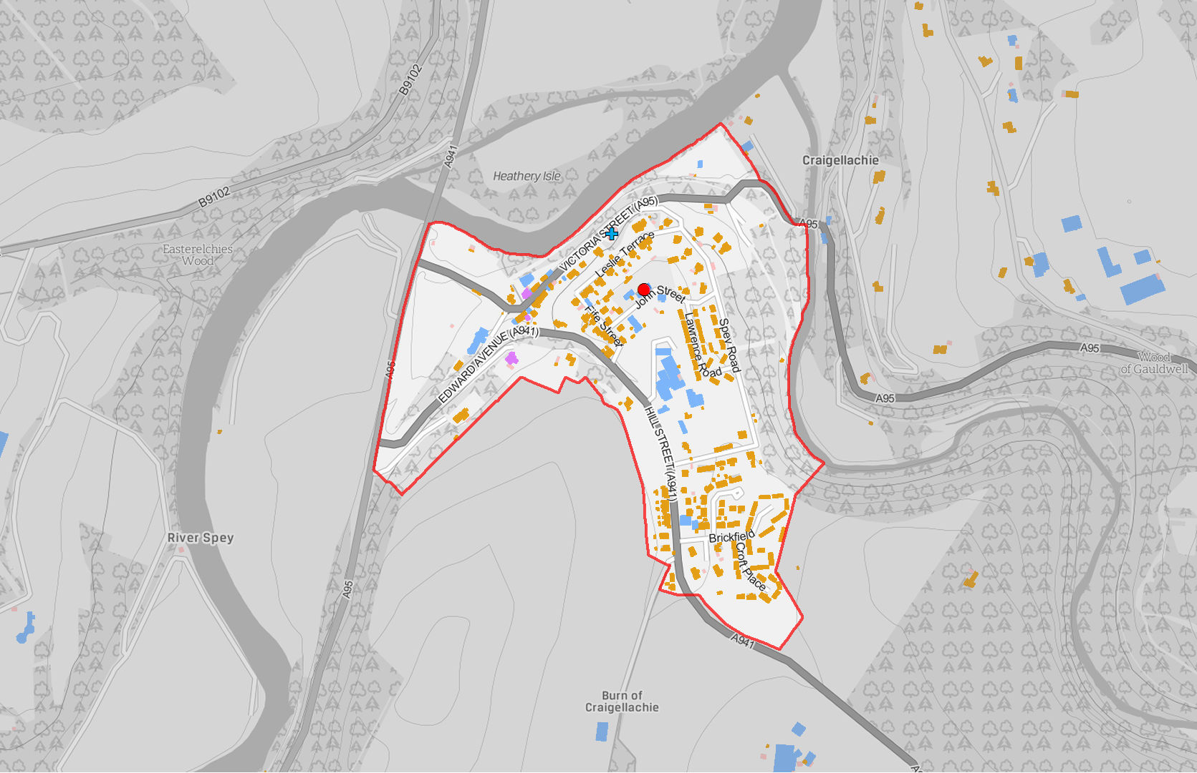
Legend
(! Nursery School
!( Primary School
!( Secondary School
GF Burial Ground GF Crematorium FG Funeral Parlour FG Mission Hall
GF Place Of Worship
Settlement Boundary
Building Use
Commercial Residential Mixed
Craigellachie
-
1:7,500 @ A4
Reproduced from the Ordnance Survey map with the permission of the Controller of Her Majesty's Stationary Office Crown Copyright 2019 The Moray Council 100023422

Slide 8
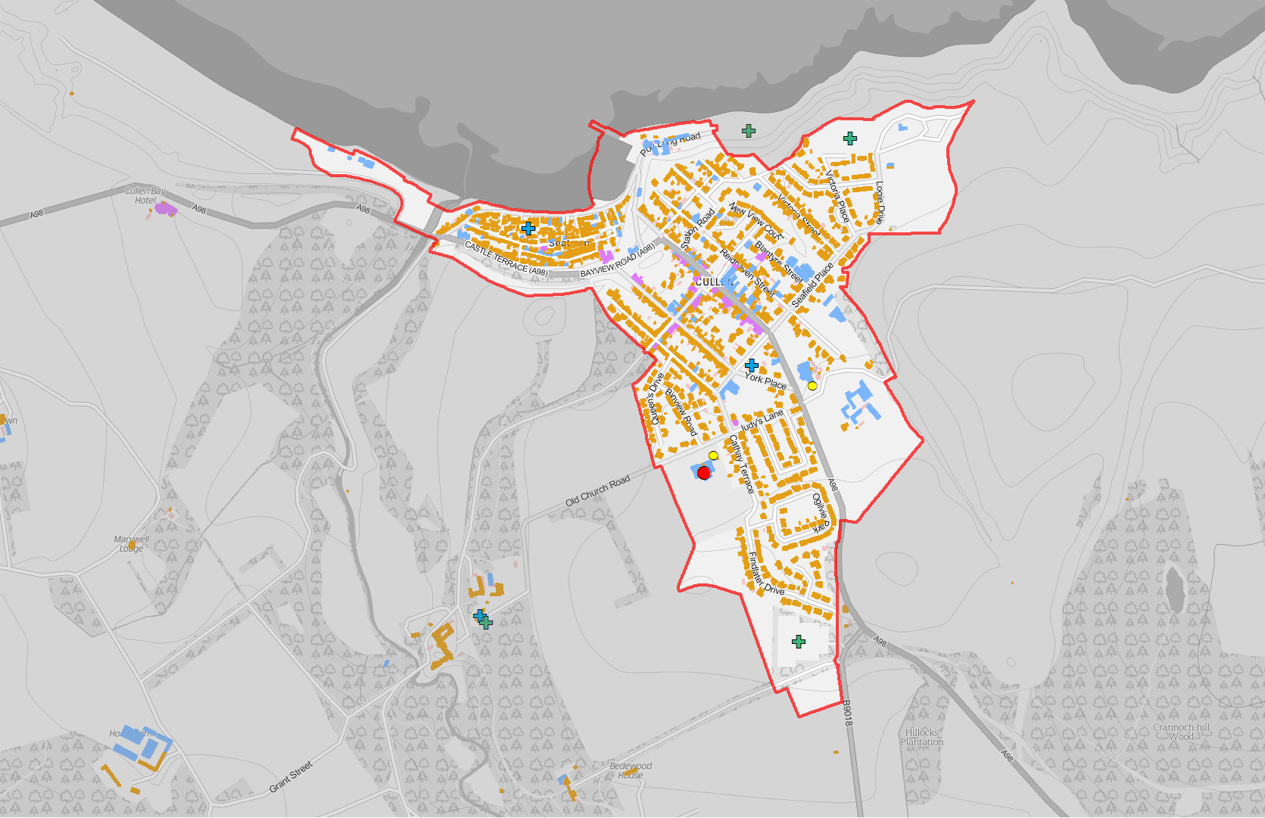
Legend
(! Nursery School
!( Primary School
!( Secondary School
FG Burial Ground FG Crematorium GF Funeral Parlour GF Mission Hall
GF Place Of Worship
Settlement Boundary
Building Use
Commercial Residential Mixed
Cullen
Reproduced from the Ordnance Survey map with the permission of the Controller of Her Majesty's Stationary Office Crown Copyright 2019 The Moray Council 100023422
-
1:10,000 @ A4

Slide 9
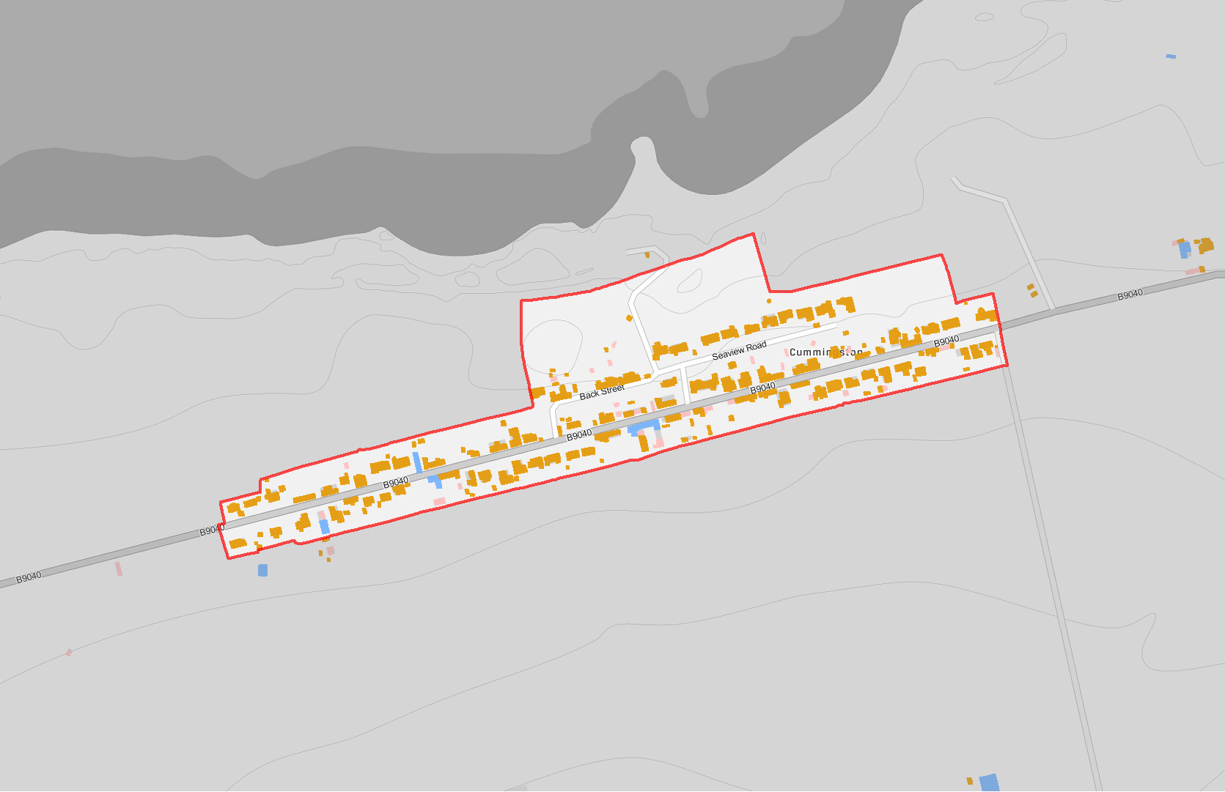
Legend
(! Nursery School
!( Primary School
!( Secondary School
GF Burial Ground GF Crematorium FG Funeral Parlour FG Mission Hall
FG Place Of Worship
Settlement Boundary
Building Use
Commercial Residential Mixed
Cummingston
Reproduced from the Ordnance Survey map with the permission of the Controller of Her Majesty's Stationary Office Crown Copyright 2019 The Moray Council 100023422
-
1:5,000 @ A4

Slide 10
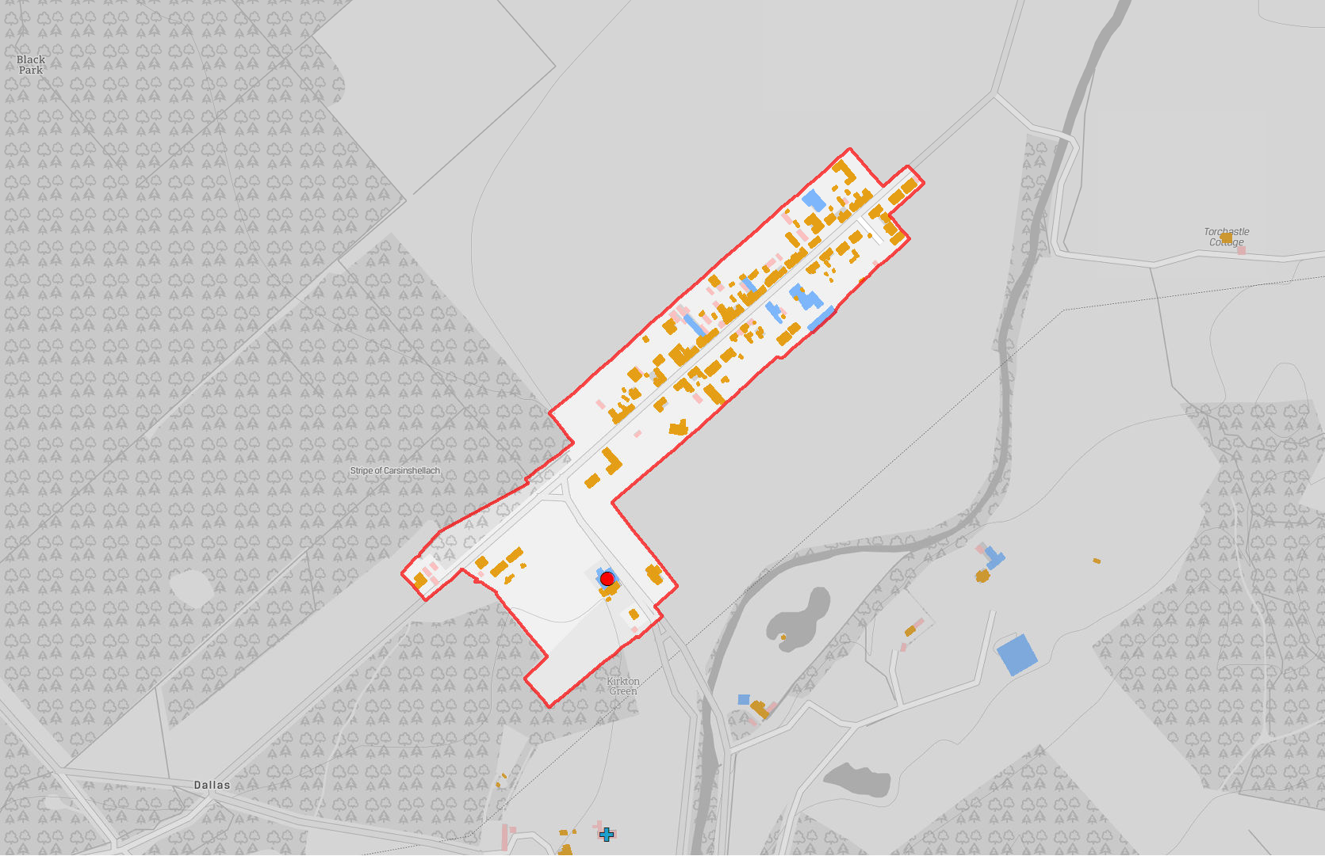
Legend
!( Nursery School
!( Primary School
!( Secondary School
GF Burial Ground FG Crematorium FG Funeral Parlour GF Mission Hall
GF Place Of Worship
Settlement Boundary
Building Use
Commercial Residential Mixed
Dallas
Reproduced from the Ordnance Survey map with the permission of the Controller of Her Majesty's Stationary Office Crown Copyright 2019 The Moray Council 100023422
-
1:5,000 @ A4

Slide 11
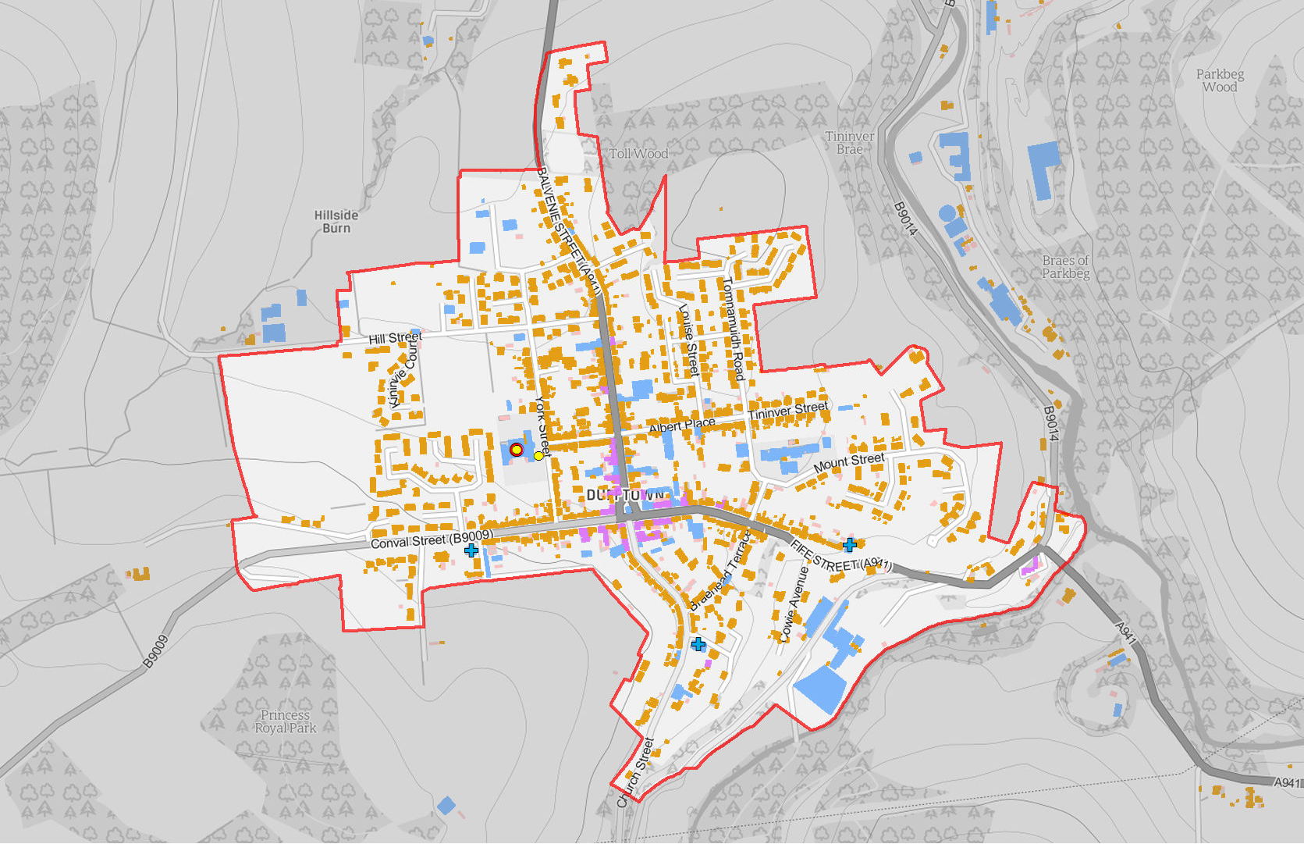
Legend
(! Nursery School
!( Primary School
!( Secondary School
GF Burial Ground FG Crematorium GF Funeral Parlour GF Mission Hall
GF Place Of Worship
Settlement Boundary
Building Use
Commercial Residential Mixed
Dufftown
Reproduced from the Ordnance Survey map with the permission of the Controller of Her Majesty's Stationary Office Crown Copyright 2019 The Moray Council 100023422
-
1:7,500 @ A4

Slide 12
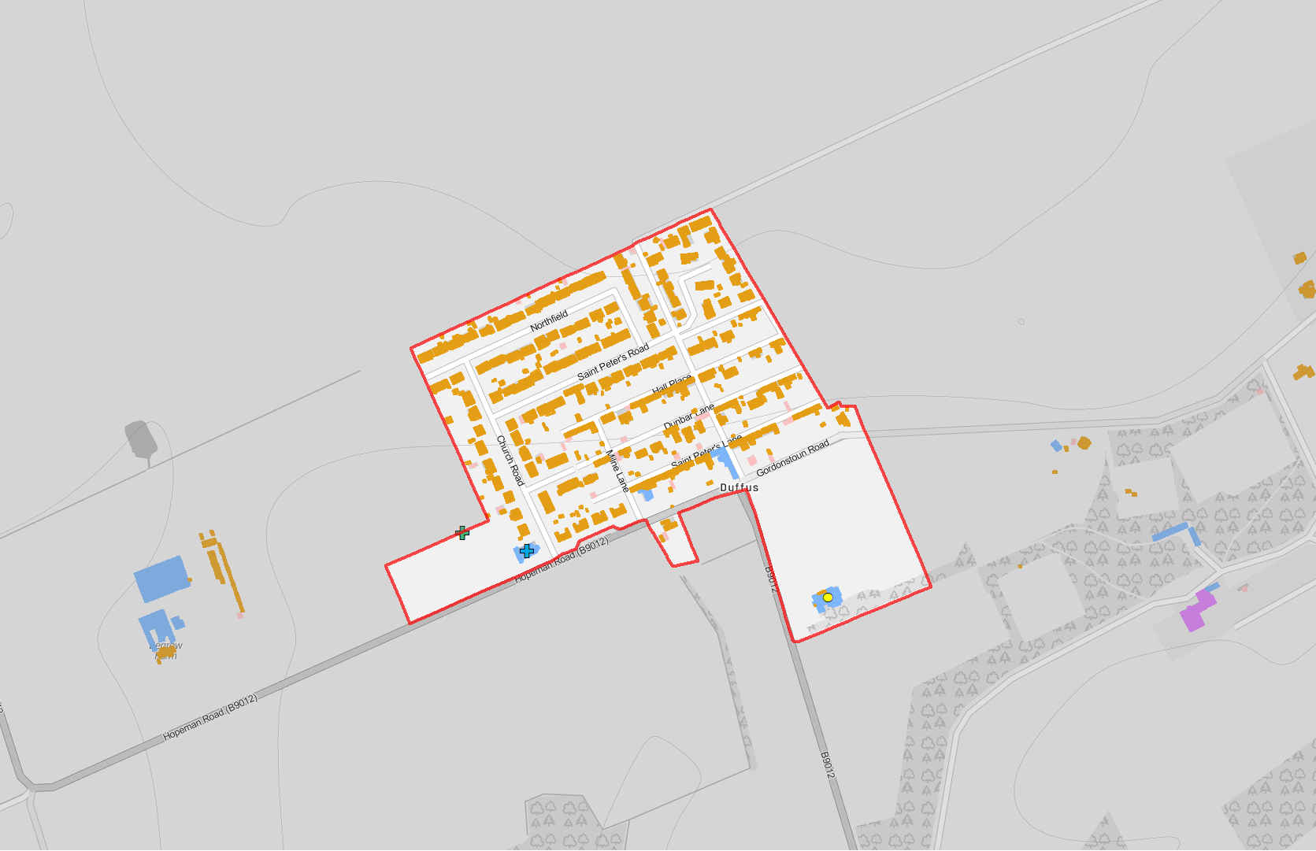
Legend
!( Nursery School
!( Primary School
!( Secondary School
GF Burial Ground FG Crematorium FG Funeral Parlour GF Mission Hall
GF Place Of Worship
Settlement Boundary
Building Use
Commercial Residential Mixed
Duffus
Reproduced from the Ordnance Survey map with the permission of the Controller of Her Majesty's Stationary Office Crown Copyright 2019 The Moray Council 100023422
-
1:5,000 @ A4

Slide 13
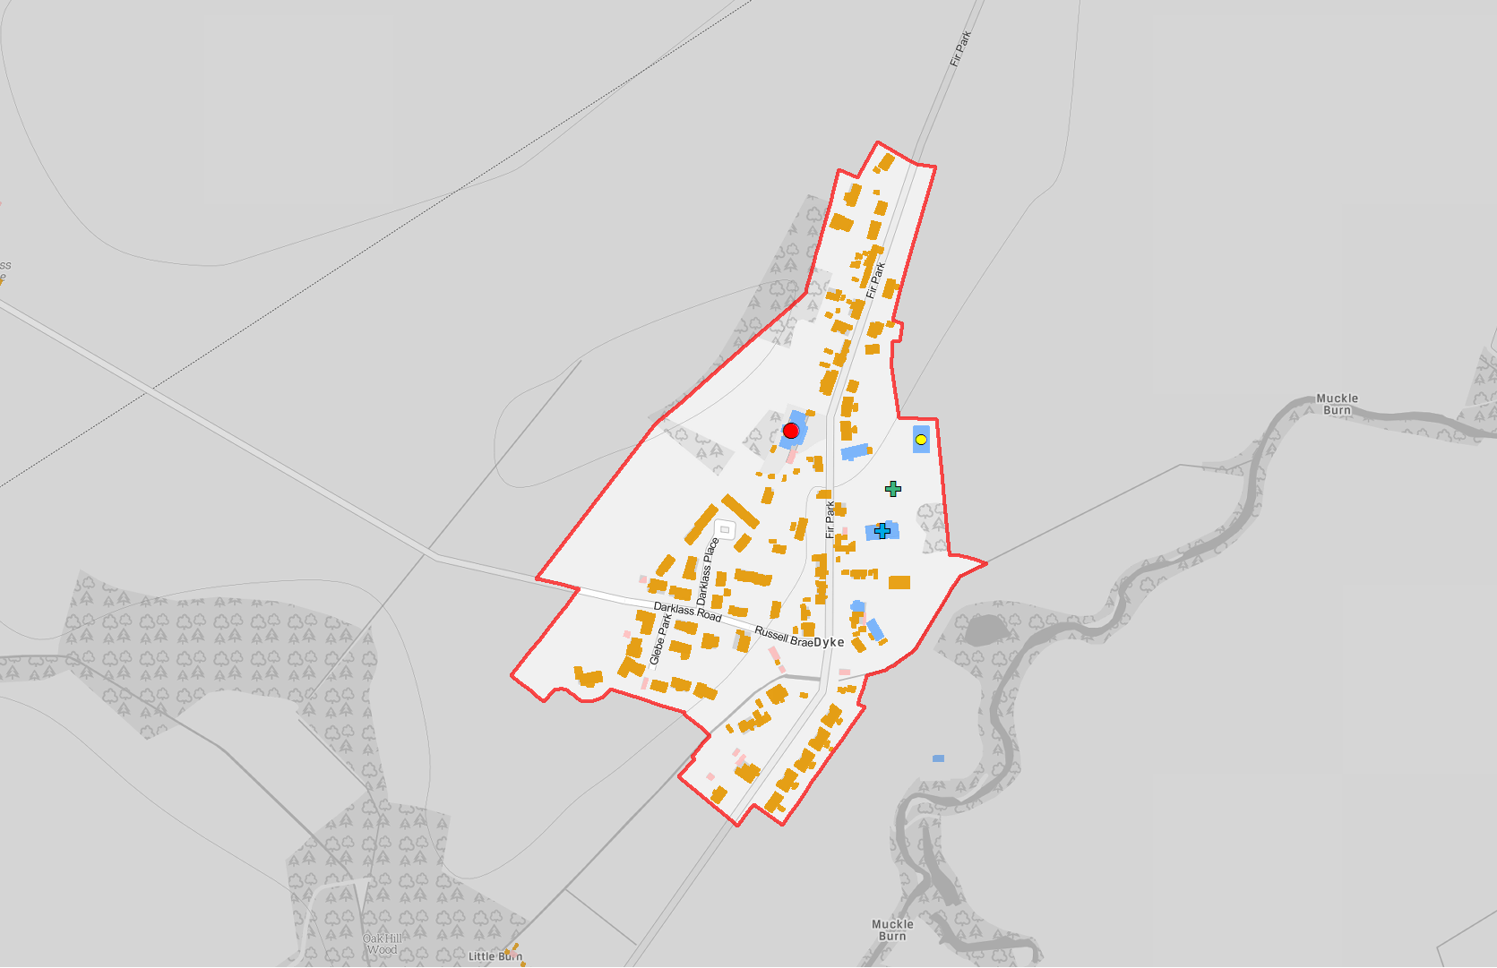
Legend
(! Nursery School
(! Primary School
!( Secondary School
GF Burial Ground FG Crematorium GF Funeral Parlour FG Mission Hall
GF Place Of Worship
Settlement Boundary
Building Use
Commercial Residential Mixed
Dyke
Reproduced from the Ordnance Survey map with the permission of the Controller of Her Majesty's Stationary Office Crown Copyright 2019 The Moray Council 100023422
-
1:5,000 @ A4

Slide 14
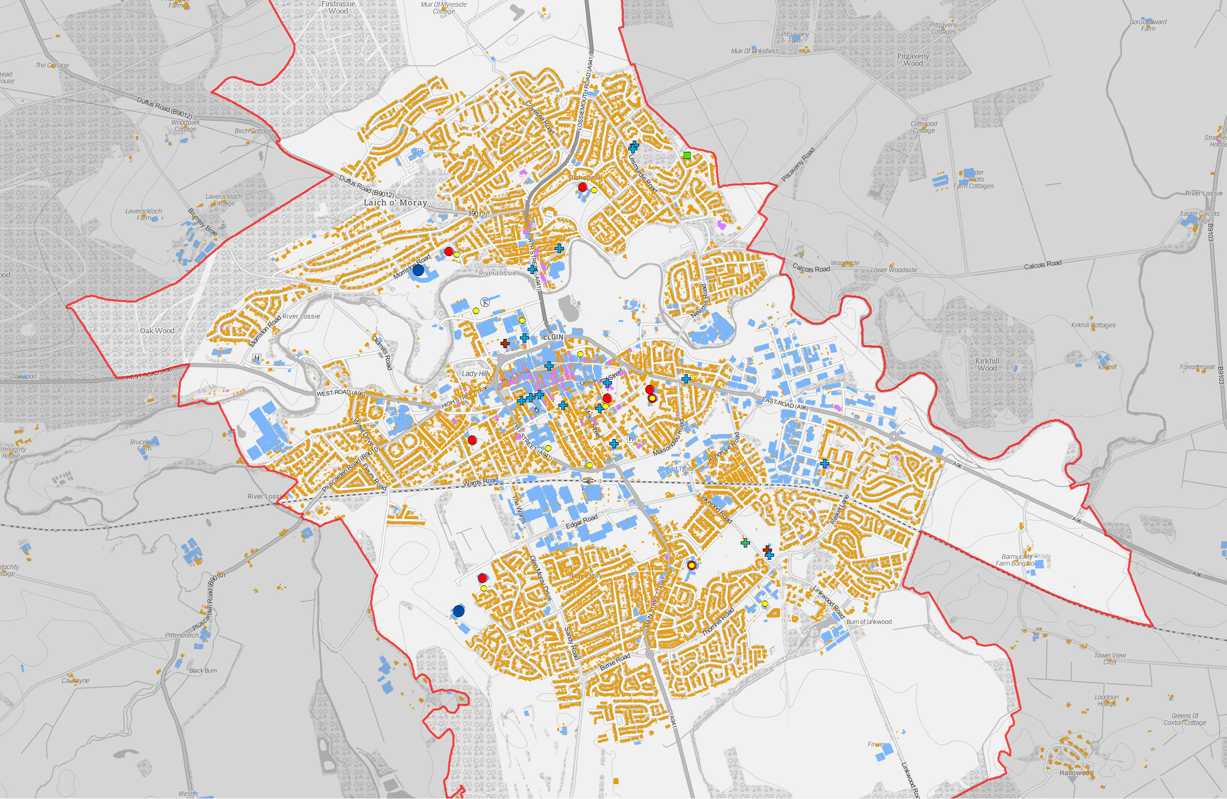
Legend
(! Nursery School
!( Primary School
!( Secondary School
GF Burial Ground GF Crematorium GF Funeral Parlour FG Mission Hall
GF Place Of Worship
)" Womens' Refuge Settlement Boundary
Building Use
Commercial Residential Mixed
Elgin - Building Use
-
1:17,500 @ A3
Reproduced from the Ordnance Survey map with the permission of the Controller of Her Majesty's Stationary Office Crown Copyright 2019 The Moray Council 100023422

Slide 15
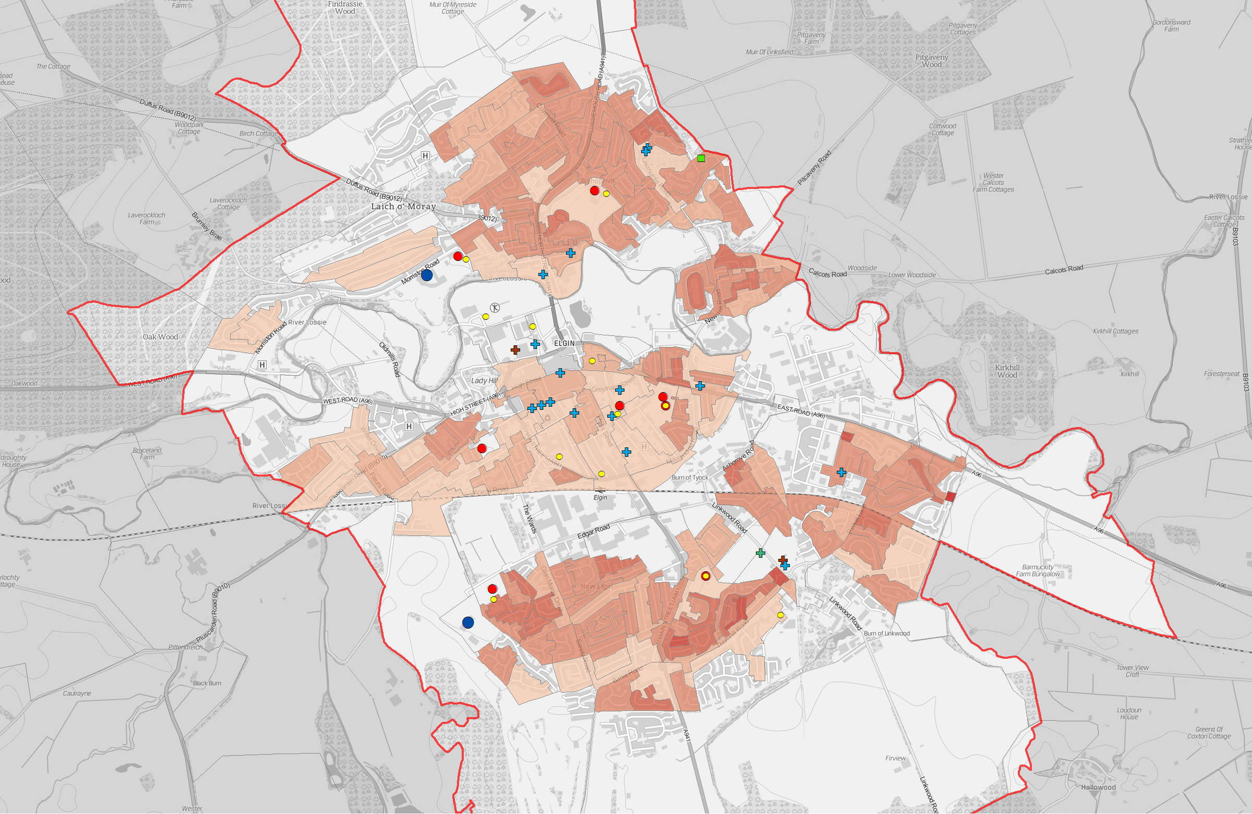
Legend
(! Nursery School
!( Primary School
!( Secondary School
GF Burial Ground GF Crematorium GF Funeral Parlour GF Mission Hall
GF Place Of Worship
") Womens' Refuge Settlement Boundary
People per Hectare
0 - 14
15 - 29
30 - 44
45 - 74
75 - 99
100 - 199
200 - 306
Elgin - Population Density (Census Output Areas 2011)
-
1:17,500 @ A3
Reproduced from the Ordnance Survey map with the permission of the Controller of Her Majesty's Stationary Office Crown Copyright 2019 The Moray Council 100023422

Slide 16
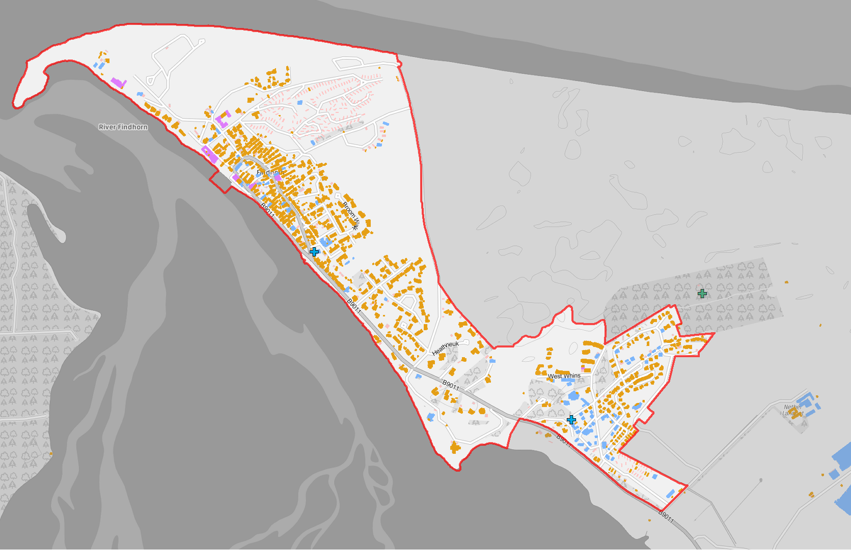
Legend
(! Nursery School
(! Primary School
!( Secondary School
GF Burial Ground GF Crematorium FG Funeral Parlour GF Mission Hall
GF Place Of Worship
Settlement Boundary
Building Use
Commercial Residential Mixed
Findhorn
-
1:10,000 @ A4
Reproduced from the Ordnance Survey map with the permission of the Controller of Her Majesty's Stationary Office Crown Copyright 2019 The Moray Council 100023422

Slide 17
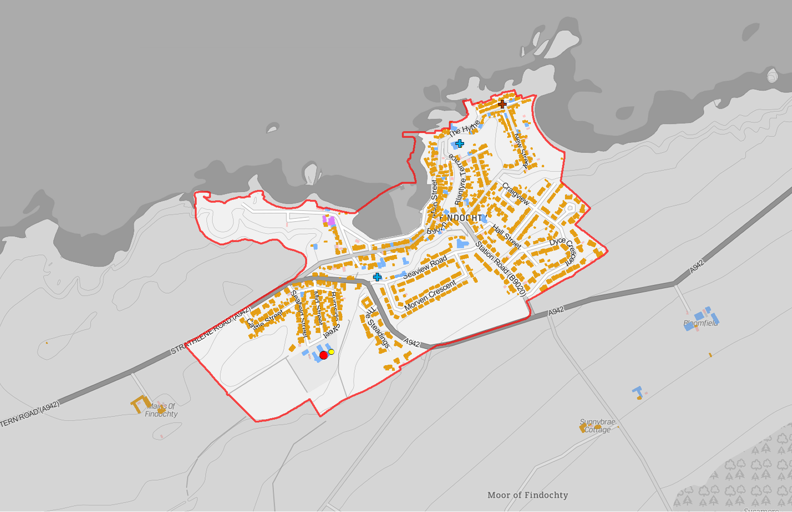
Legend
(! Nursery School
(! Primary School
!( Secondary School
GF Burial Ground GF Crematorium FG Funeral Parlour GF Mission Hall
GF Place Of Worship
Settlement Boundary
Building Use
Commercial Residential Mixed
Findochty
-
1:7,500 @ A4
Reproduced from the Ordnance Survey map with the permission of the Controller of Her Majesty's Stationary Office Crown Copyright 2019 The Moray Council 100023422

Slide 18
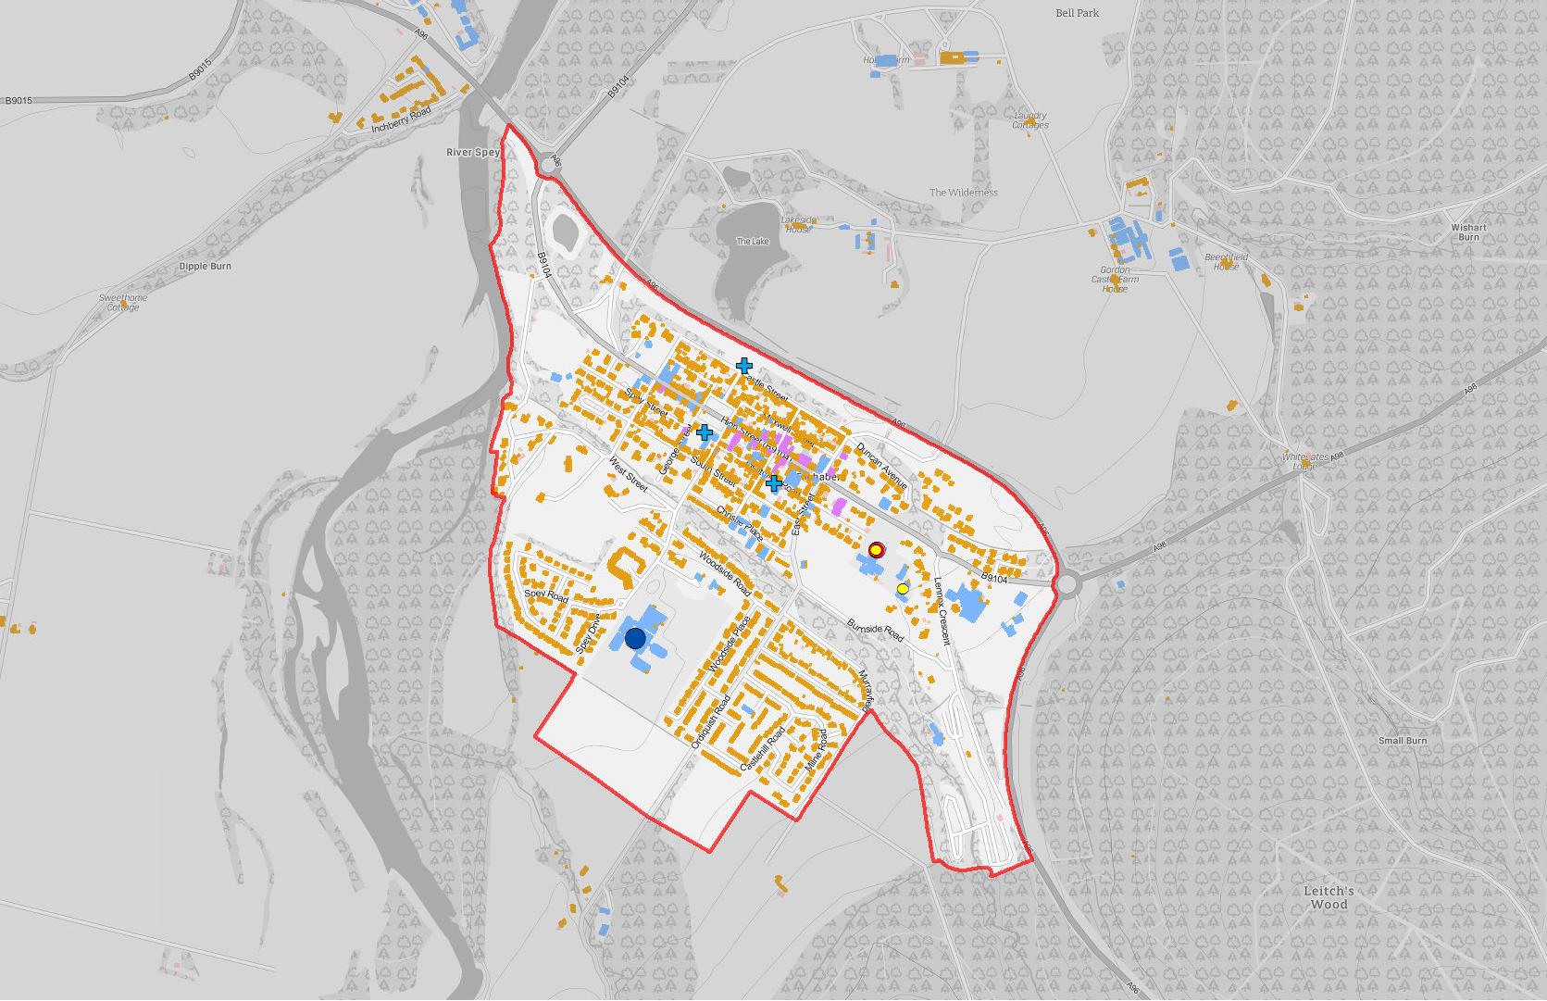
Legend
(! Nursery School
(! Primary School
!( Secondary School
GF Burial Ground GF Crematorium FG Funeral Parlour GF Mission Hall
GF Place Of Worship
Settlement Boundary
Building Use
Commercial Residential Mixed
Fochabers
Reproduced from the Ordnance Survey map with the permission of the Controller of Her Majesty's Stationary Office Crown Copyright 2019 The Moray Council 100023422
-
1:12,000 @ A4

Slide 19
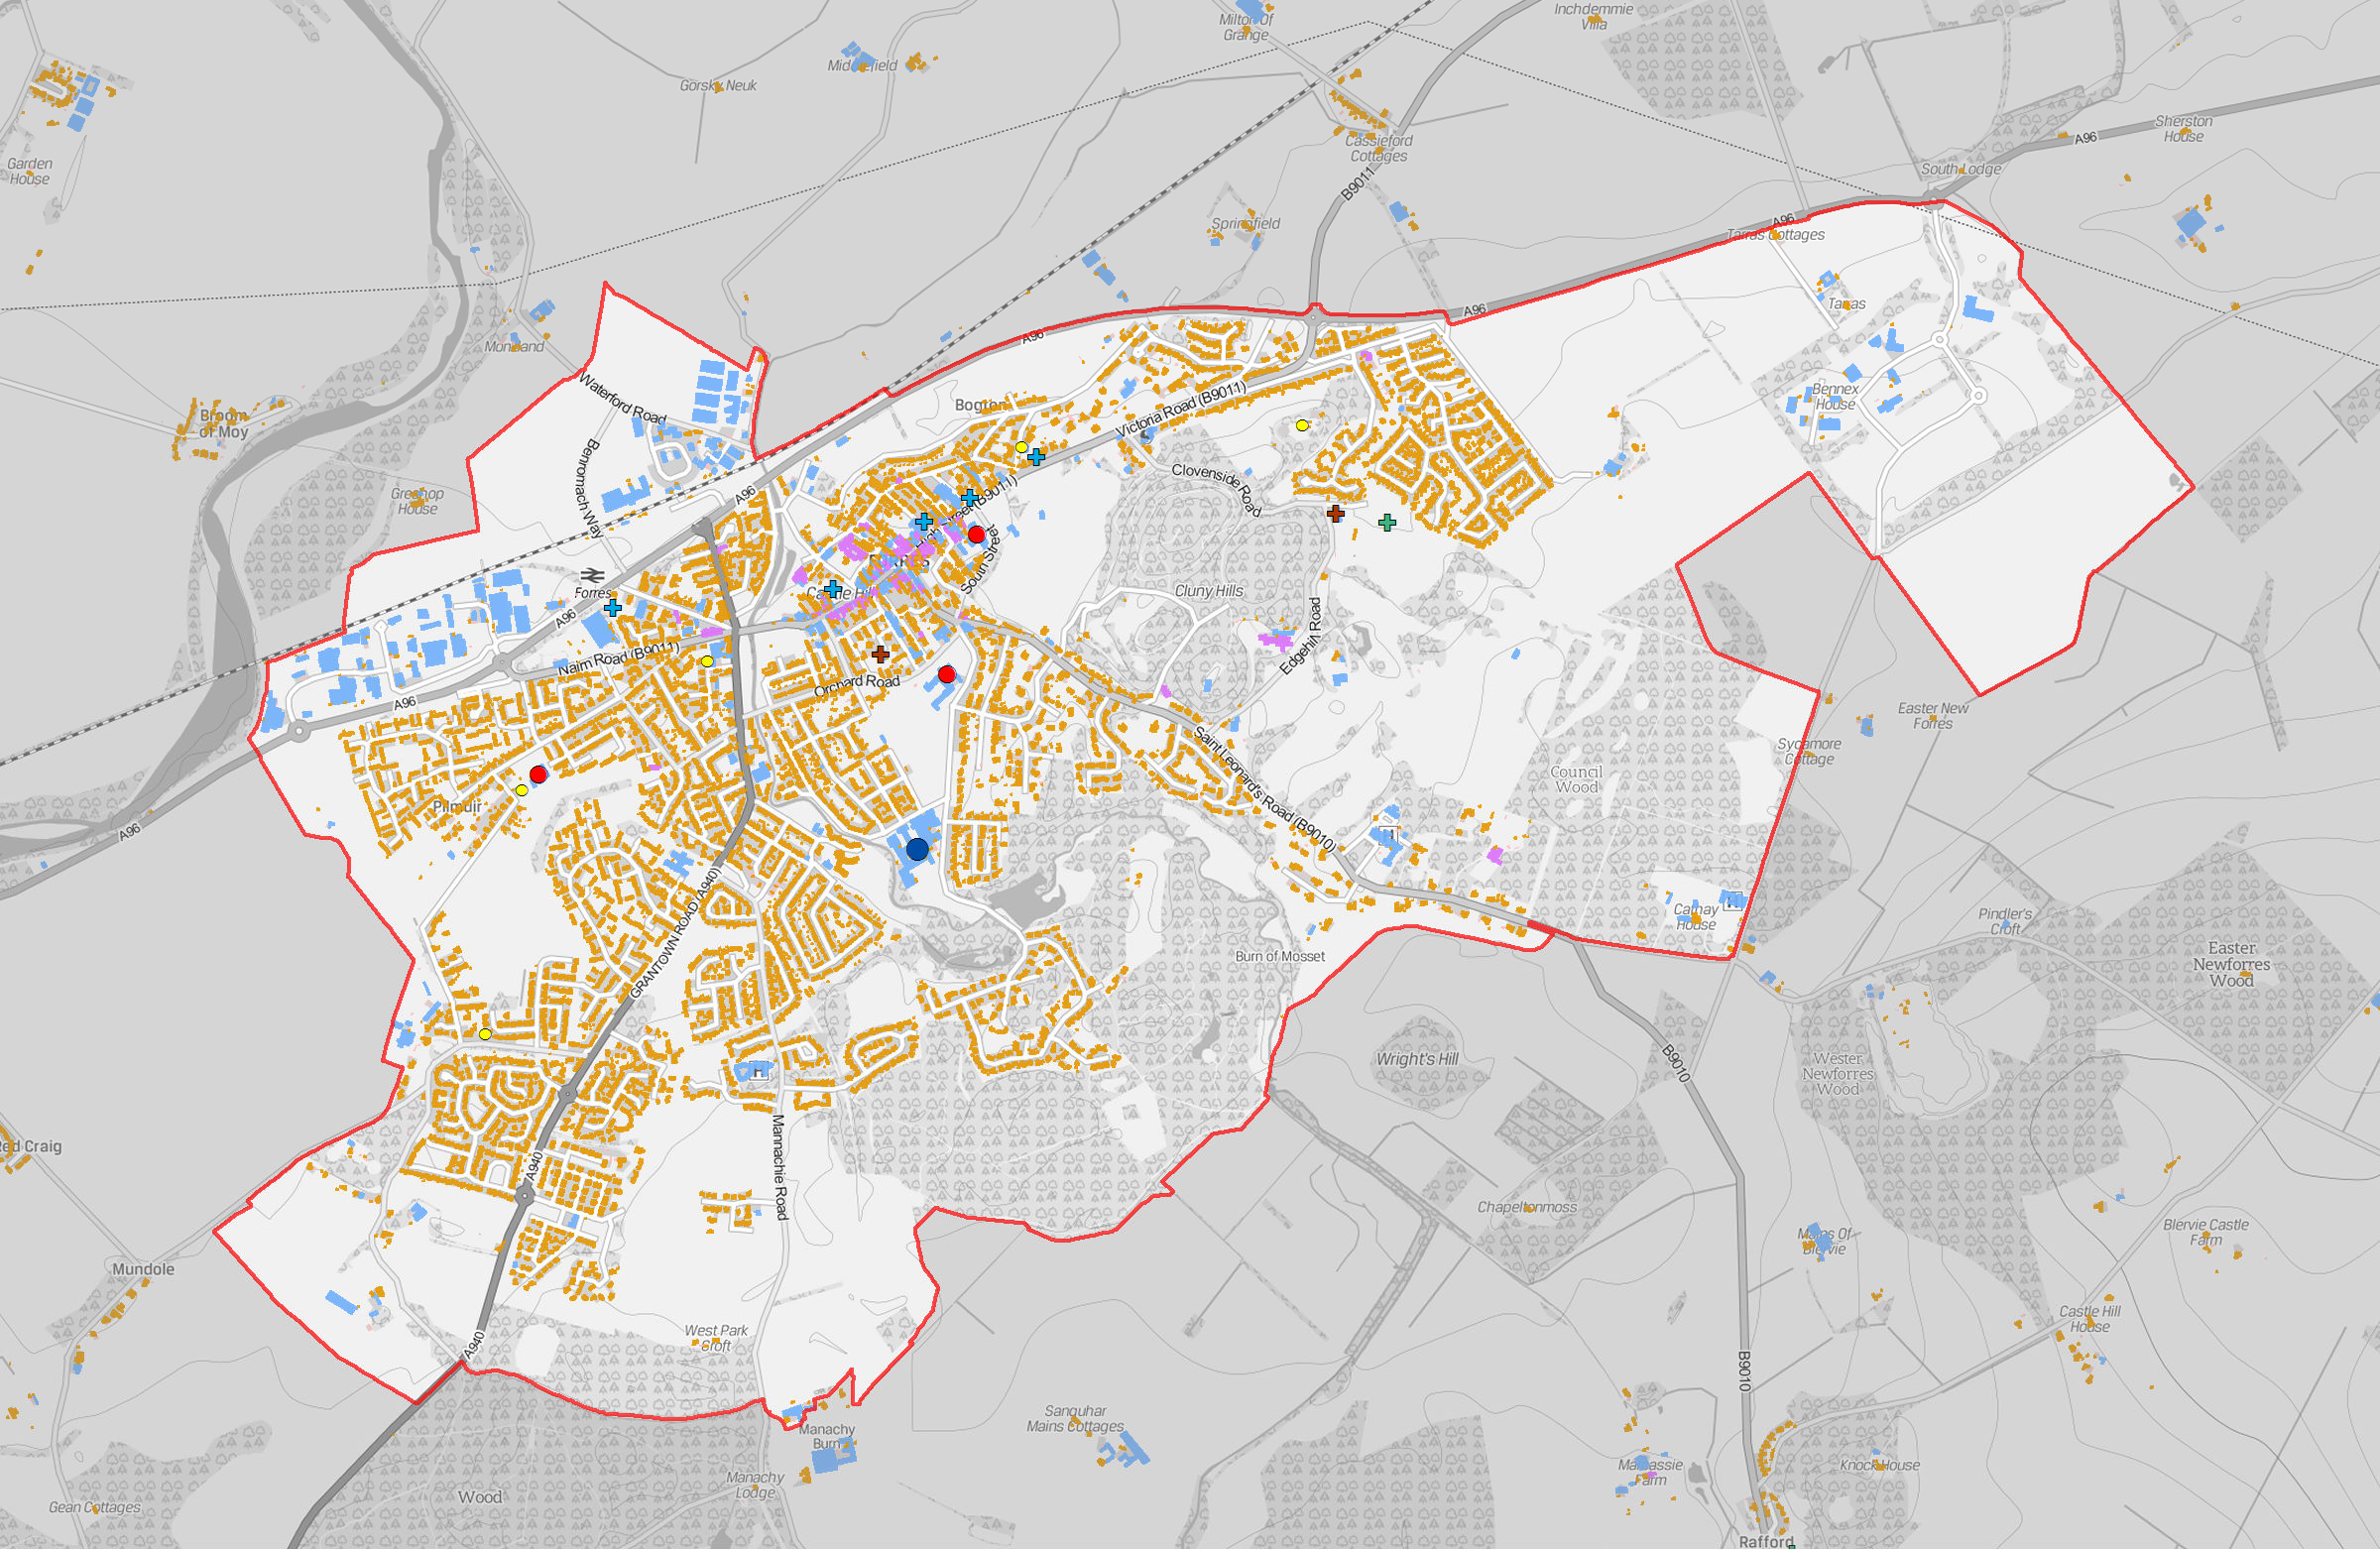
Legend
!( Nursery School
!( Primary School
(! Secondary School
GF Burial Ground FG Crematorium GF Funeral Parlour GF Mission Hall
GF Place Of Worship Settlement Boundary
Building Use
Commercial Residential Mixed
Forres - Building Use
-
1:15,000 @ A3
Reproduced from the Ordnance Survey map with the permission of the Controller of Her Majesty's Stationary Office Crown Copyright 2019 The Moray Council 100023422

Slide 20
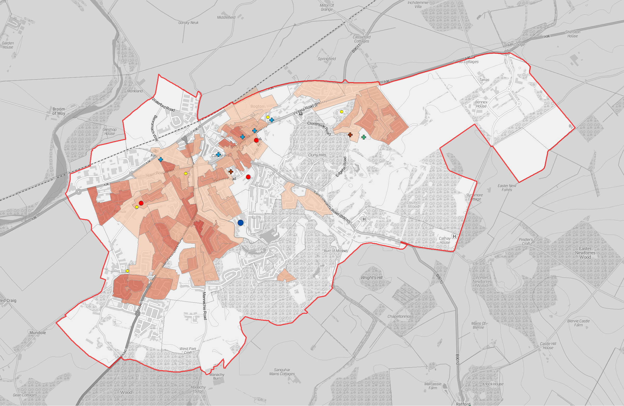
Legend
!( Nursery School
!( Primary School
!( Secondary School
FG Burial Ground GF Crematorium GF Funeral Parlour FG Mission Hall
GF Place Of Worship
Settlement Boundary
People per Hectare
0 - 14
15 - 29
30 - 44
45 - 74
75 - 99
100 - 199
200 - 306
Forres - Population Density (Census Output Areas 2011)
-
1:15,000 @ A3
Reproduced from the Ordnance Survey map with the permission of the Controller of Her Majesty's Stationary Office Crown Copyright 2019 The Moray Council 100023422

Slide 21
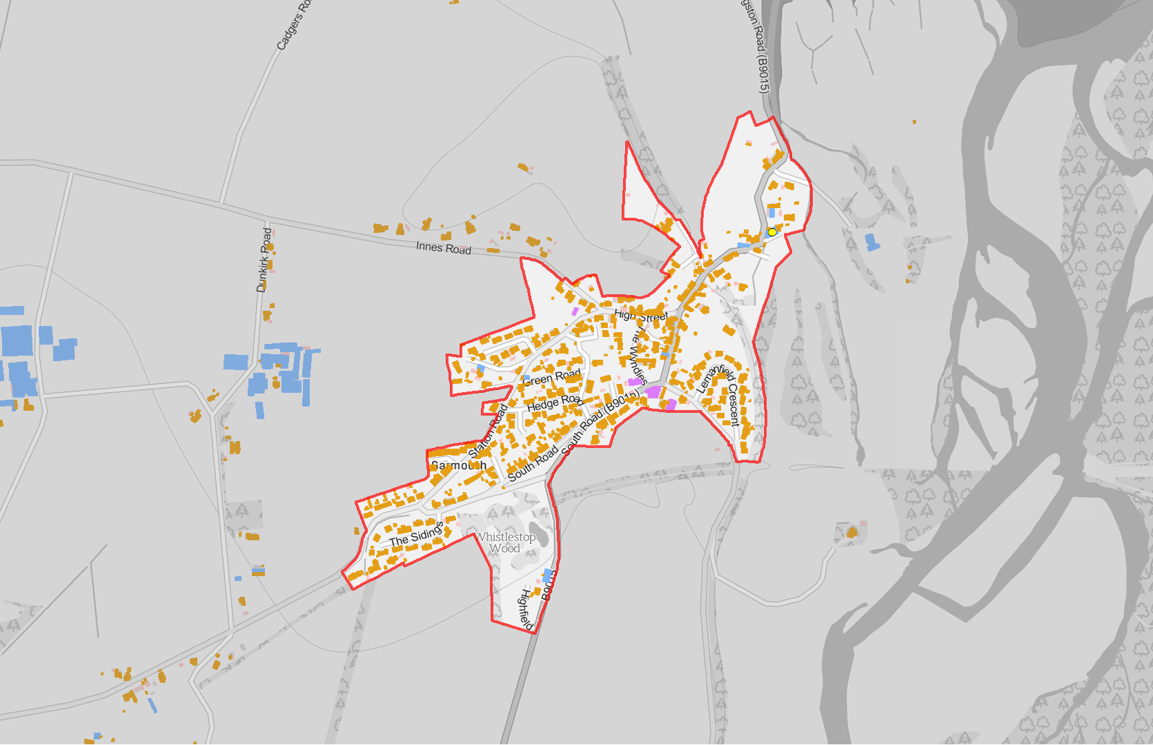
Legend
(! Nursery School
!( Primary School
!( Secondary School
GF Burial Ground FG Crematorium GF Funeral Parlour GF Mission Hall
GF Place Of Worship
Settlement Boundary
Building Use
Commercial Residential Mixed
Garmouth
-
1:7,500 @ A4
Reproduced from the Ordnance Survey map with the permission of the Controller of Her Majesty's Stationary Office Crown Copyright 2019 The Moray Council 100023422

Slide 22
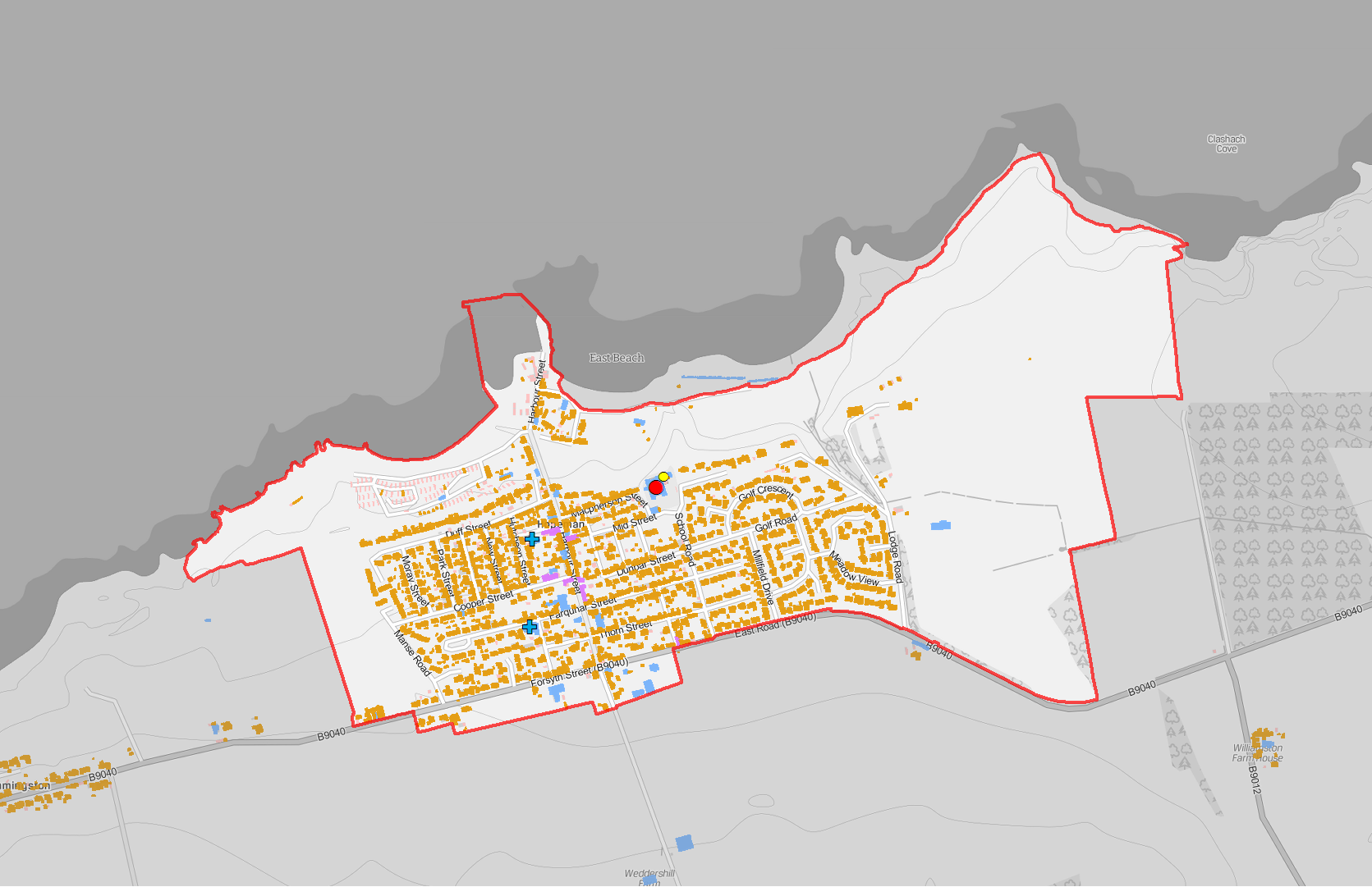
Legend
(! Nursery School
!( Primary School
!( Secondary School
GF Burial Ground FG Crematorium GF Funeral Parlour GF Mission Hall
GF Place Of Worship
Settlement Boundary
Building Use
Commercial Residential Mixed
Hopeman
-
1:10,000 @ A4
Reproduced from the Ordnance Survey map with the permission of the Controller of Her Majesty's Stationary Office Crown Copyright 2019 The Moray Council 100023422

Slide 23
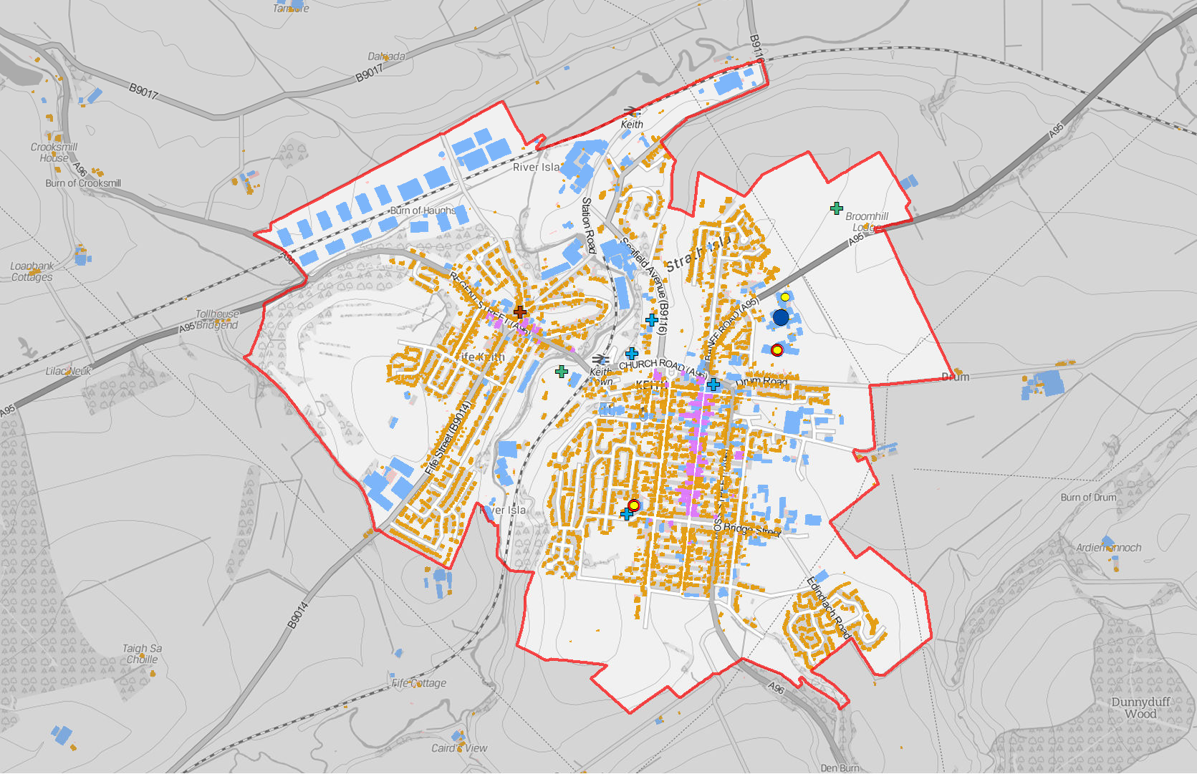
Legend
!( Nursery School
!( Primary School
!( Secondary School
GF Burial Ground GF Crematorium GF Funeral Parlour GF Mission Hall
GF Place Of Worship
Settlement Boundary
Building Use
Commercial Residential Mixed
Keith - Building Use
Reproduced from the Ordnance Survey map with the permission of the Controller of Her Majesty's Stationary Office Crown Copyright 2019 The Moray Council 100023422
-
1:15,000 @ A4

Slide 24
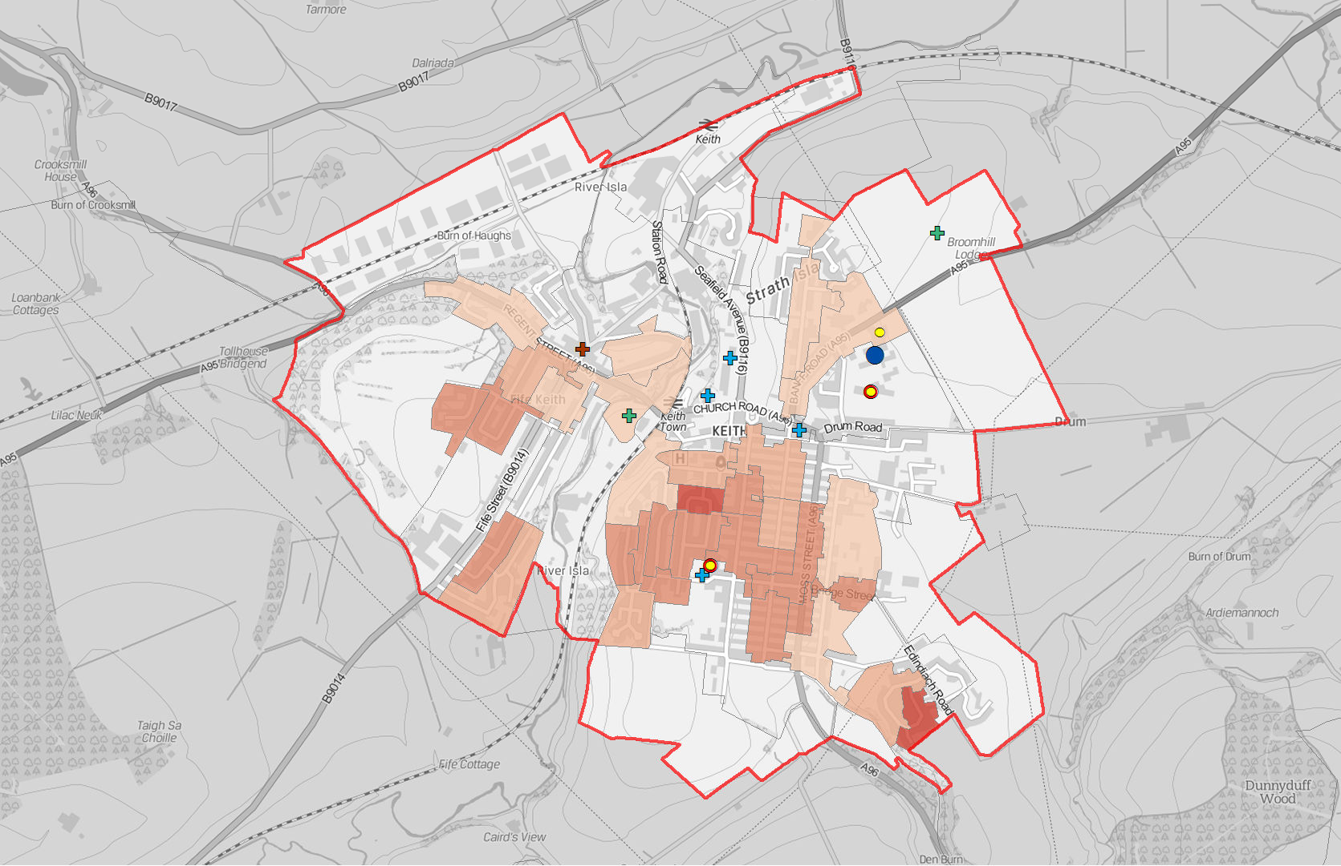
Legend
(! Nursery School
!( Primary School
!( Secondary School
FG Burial Ground GF Crematorium GF Funeral Parlour GF Mission Hall
FG Place Of Worship
Settlement Boundary
People per Hectare
0 - 14
15 - 29
30 - 44
45 - 74
75 - 99
100 - 199
200 - 306
Keith - Population Density (Census Output Areas 2011)
Reproduced from the Ordnance Survey map with the permission of the Controller of Her Majesty's Stationary Office Crown Copyright 2019 The Moray Council 100023422
-
1:15,000 @ A4

Slide 25
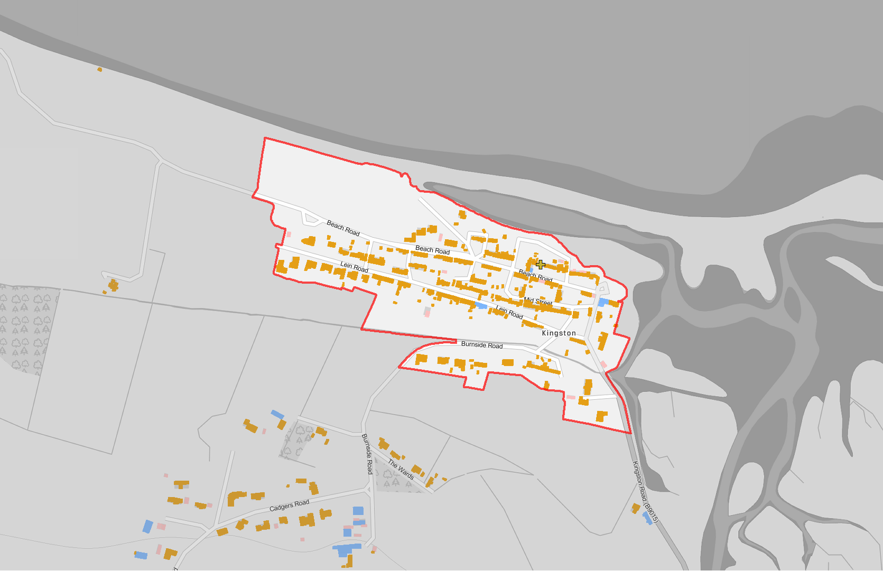
Legend
!( Nursery School
(! Primary School
(! Secondary School
GF Burial Ground GF Crematorium FG Funeral Parlour GF Mission Hall
GF Place Of Worship
Settlement Boundary
Building Use
Commercial Residential Mixed
Kingston-on-Spey
Reproduced from the Ordnance Survey map with the permission of the Controller of Her Majesty's Stationary Office Crown Copyright 2019 The Moray Council 100023422
-
1:5,000 @ A4

Slide 26
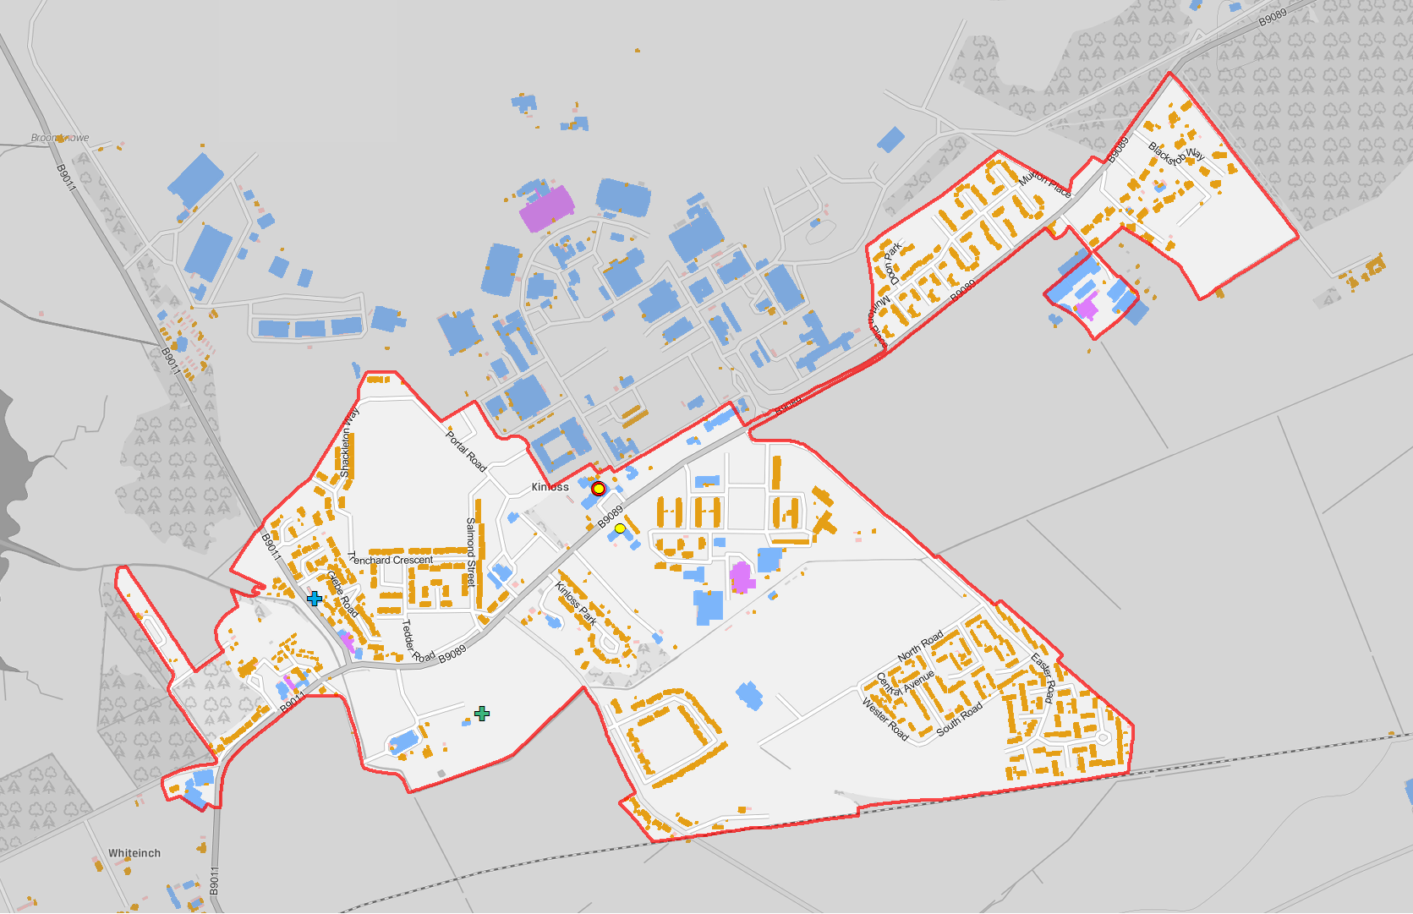
Legend
(! Nursery School
!( Primary School
!( Secondary School
GF Burial Ground FG Crematorium GF Funeral Parlour GF Mission Hall
GF Place Of Worship
Settlement Boundary
Building Use
Commercial Residential Mixed
Kinloss
Reproduced from the Ordnance Survey map with the permission of the Controller of Her Majesty's Stationary Office Crown Copyright 2019 The Moray Council 100023422
-
1:10,000 @ A4

Slide 27
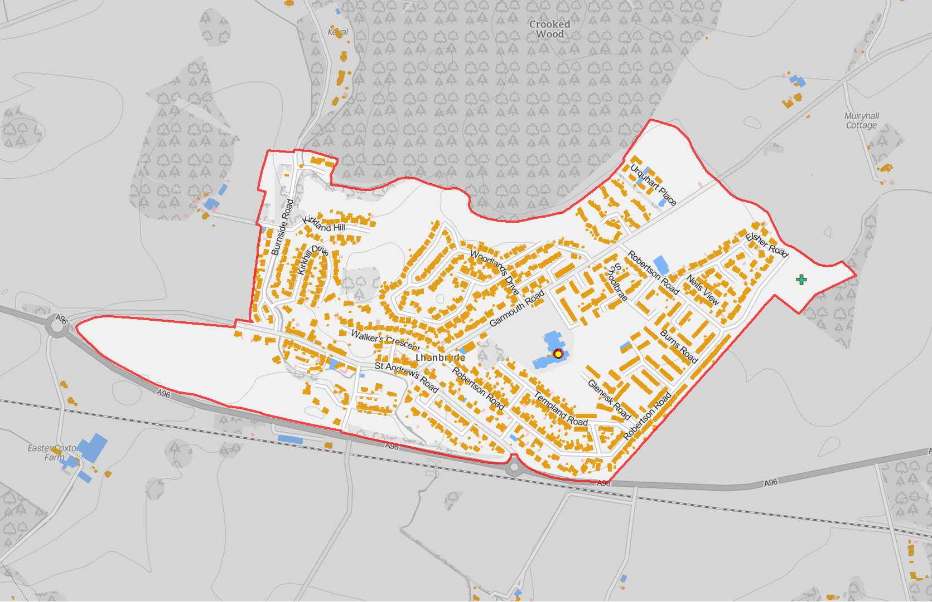
Legend
(! Nursery School
(! Primary School
!( Secondary School
GF Burial Ground GF Crematorium FG Funeral Parlour GF Mission Hall
GF Place Of Worship
Settlement Boundary
Building Use
Commercial Residential Mixed
Lhanbryde
Reproduced from the Ordnance Survey map with the permission of the Controller of Her Majesty's Stationary Office Crown Copyright 2019 The Moray Council 100023422
-
1:7,500 @ A4

Slide 28
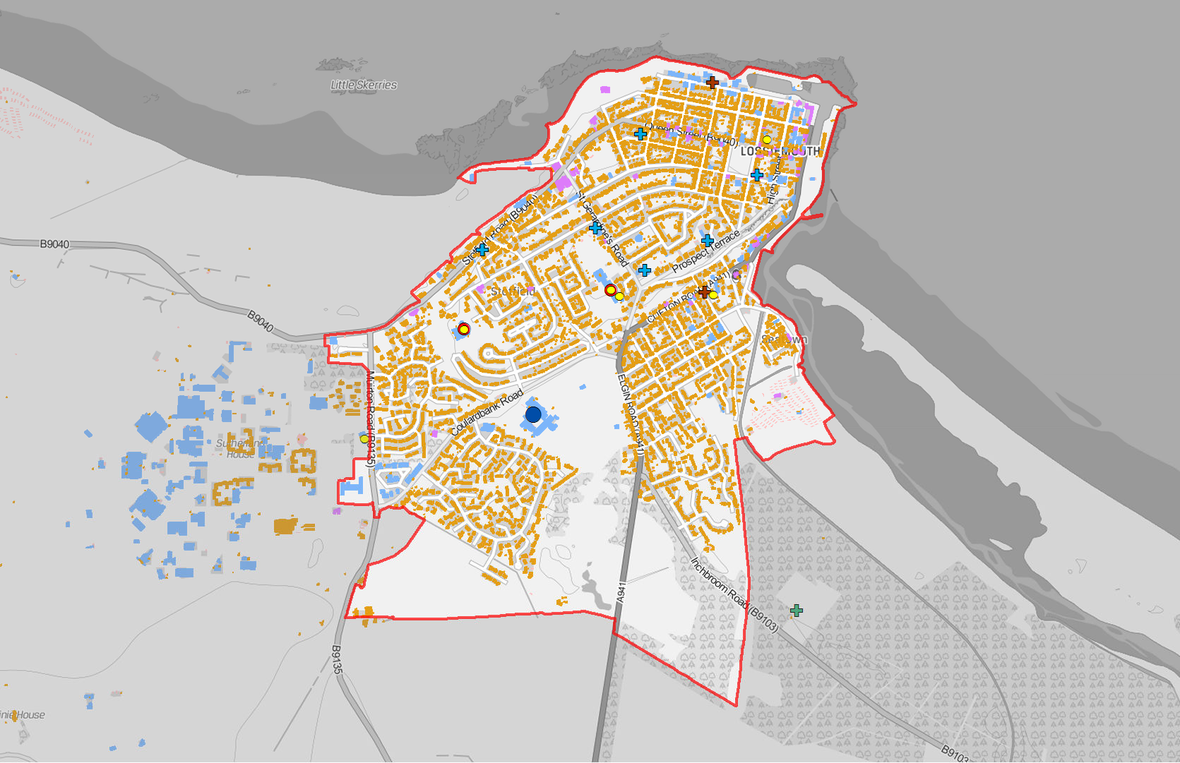
Legend
!( Nursery School
!( Primary School
!( Secondary School
GF Burial Ground GF Crematorium FG Funeral Parlour GF Mission Hall
FG Place Of Worship Settlement Boundary
Building Use
Commercial Residential Mixed
Lossiemouth - Building Use
Reproduced from the Ordnance Survey map with the permission of the Controller of Her Majesty's Stationary Office Crown Copyright 2019 The Moray Council 100023422
-
1:15,000 @ A4

Slide 29
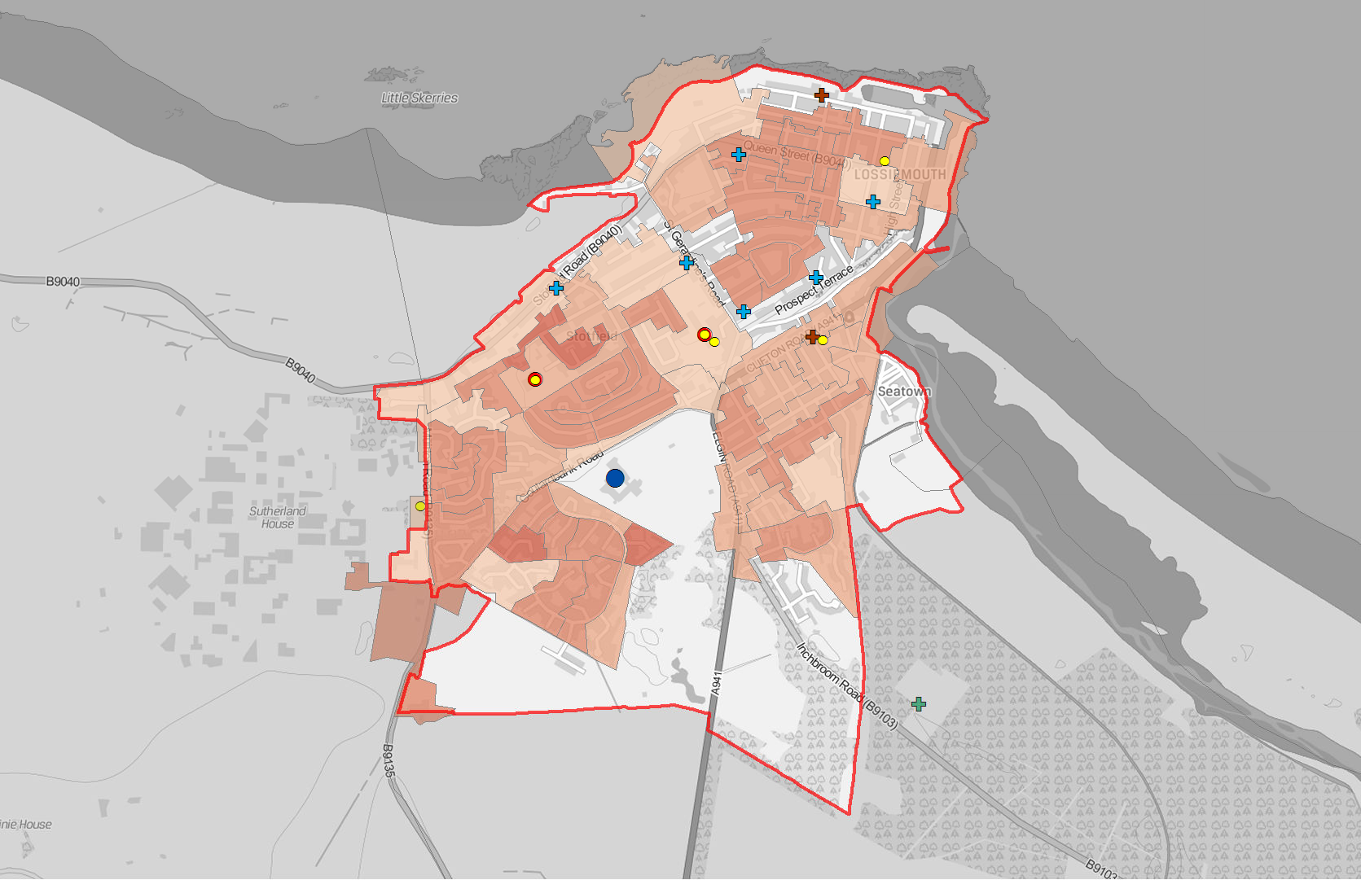
Legend
(! Nursery School
(! Primary School
!( Secondary School
GF Burial Ground GF Crematorium FG Funeral Parlour GF Mission Hall
GF Place Of Worship
Settlement Boundary
People per Hectare
0 - 14
15 - 29
30 - 44
45 - 74
75 - 99
100 - 199
200 - 306
Lossiemouth - Population Density (Census Output Areas 2011)
Reproduced from the Ordnance Survey map with the permission of the Controller of Her Majesty's Stationary Office Crown Copyright 2019 The Moray Council 100023422
-
1:15,000 @ A4

Slide 30
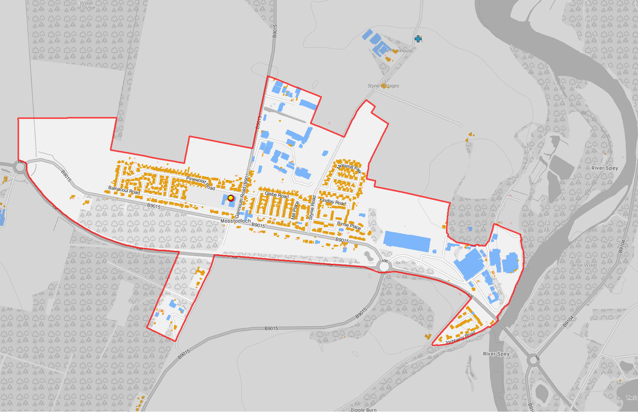
Legend
(! Nursery School
!( Primary School
!( Secondary School
GF Burial Ground GF Crematorium FG Funeral Parlour FG Mission Hall
FG Place Of Worship
Settlement Boundary
Building Use
Commercial Residential Mixed
Mosstodloch
Reproduced from the Ordnance Survey map with the permission of the Controller of Her Majesty's Stationary Office Crown Copyright 2019 The Moray Council 100023422
-
1:10,000 @ A4

Slide 31
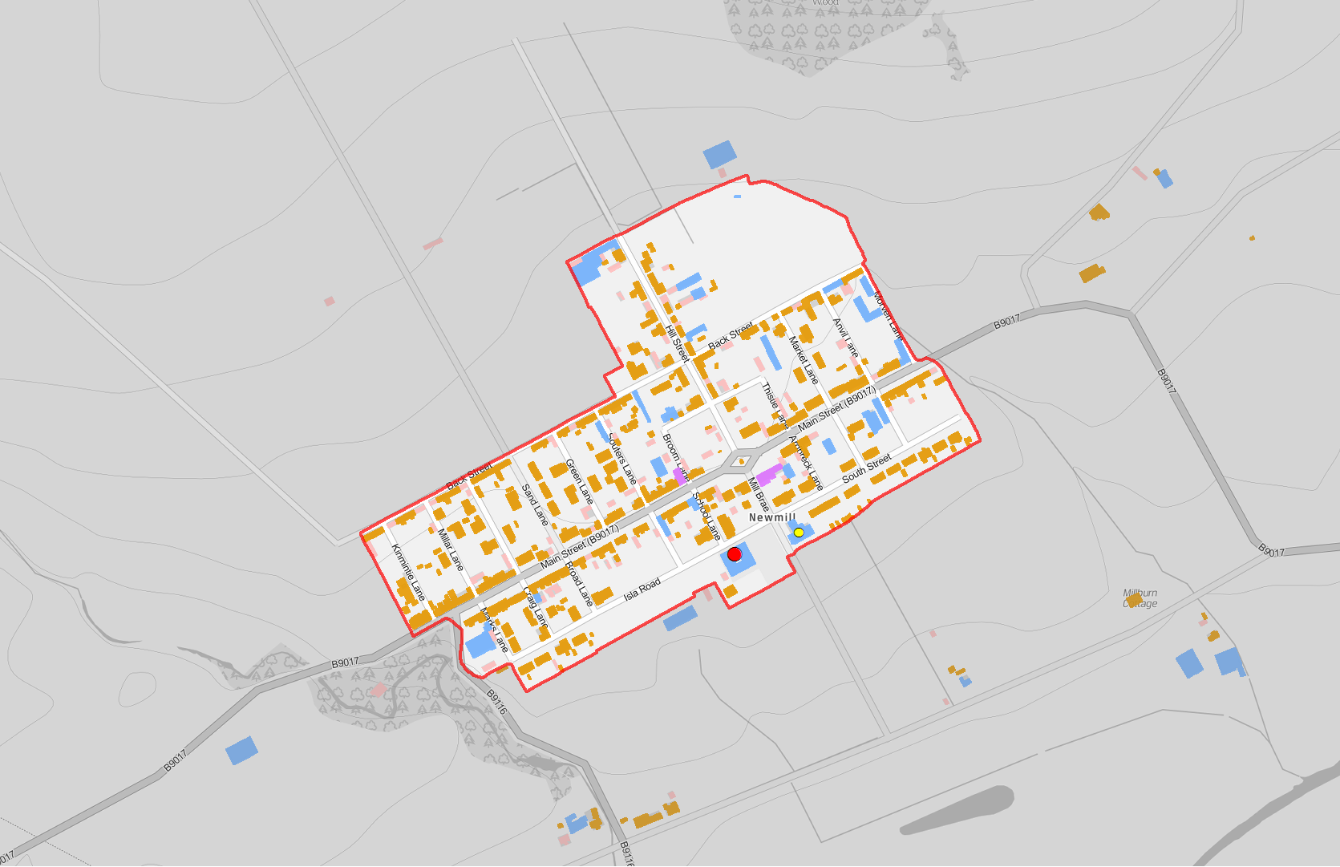
Legend
(! Nursery School
!( Primary School
!( Secondary School
FG Burial Ground FG Crematorium GF Funeral Parlour GF Mission Hall
GF Place Of Worship
Settlement Boundary
Building Use
Commercial Residential Mixed
Newmill
Reproduced from the Ordnance Survey map with the permission of the Controller of Her Majesty's Stationary Office Crown Copyright 2019 The Moray Council 100023422
-
1:5,000 @ A4

Slide 32
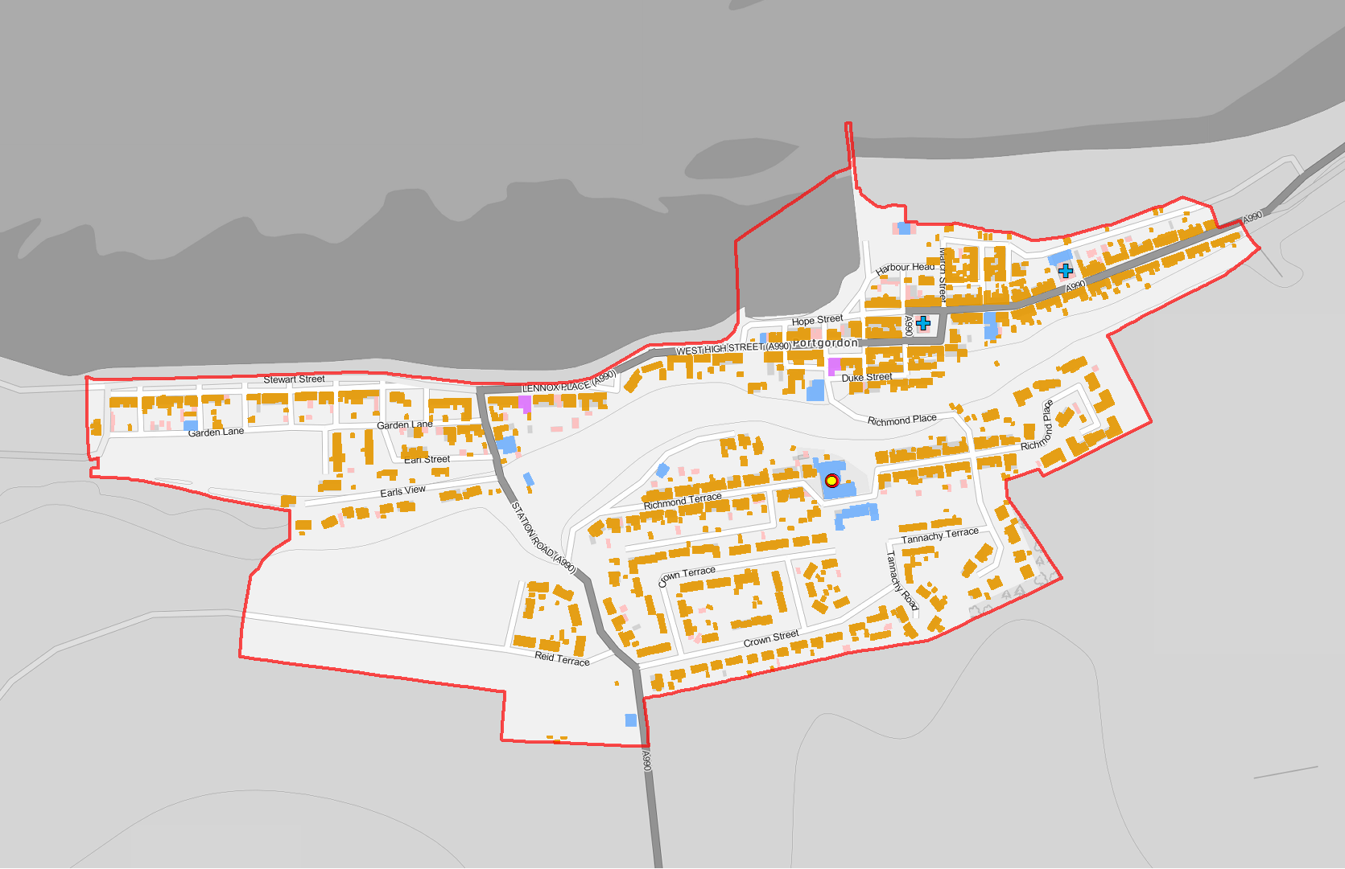
Legend
(! Nursery School
(! Primary School
!( Secondary School
GF Burial Ground GF Crematorium FG Funeral Parlour GF Mission Hall
GF Place Of Worship
Settlement Boundary
Building Use
Commercial Residential Mixed
Portgordon
Reproduced from the Ordnance Survey map with the permission of the Controller of Her Majesty's Stationary Office Crown Copyright 2019 The Moray Council 100023422
-
1:5,000 @ A4

Slide 33
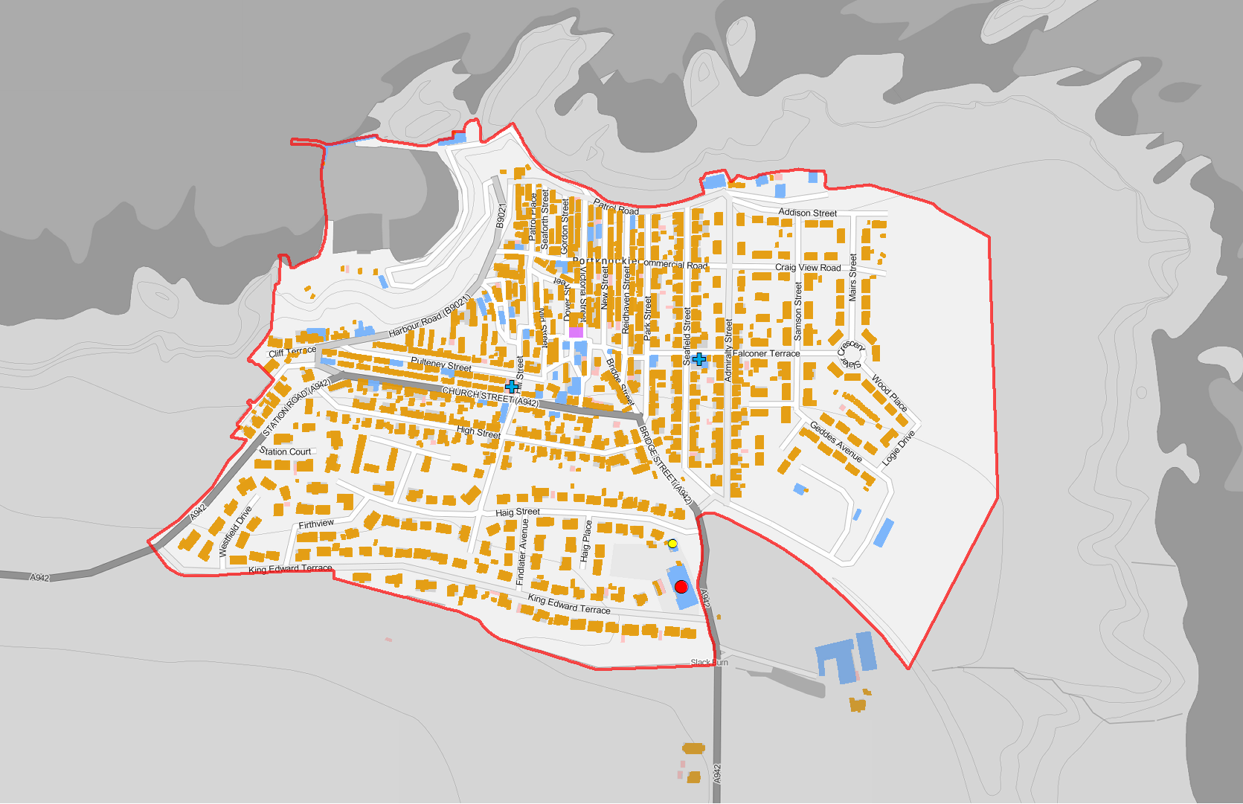
Legend
(! Nursery School
!( Primary School
!( Secondary School
GF Burial Ground GF Crematorium FG Funeral Parlour FG Mission Hall
FG Place Of Worship
Settlement Boundary
Building Use
Commercial Residential Mixed
Portknockie
Reproduced from the Ordnance Survey map with the permission of the Controller of Her Majesty's Stationary Office Crown Copyright 2019 The Moray Council 100023422
-
1:5,000 @ A4

Slide 34
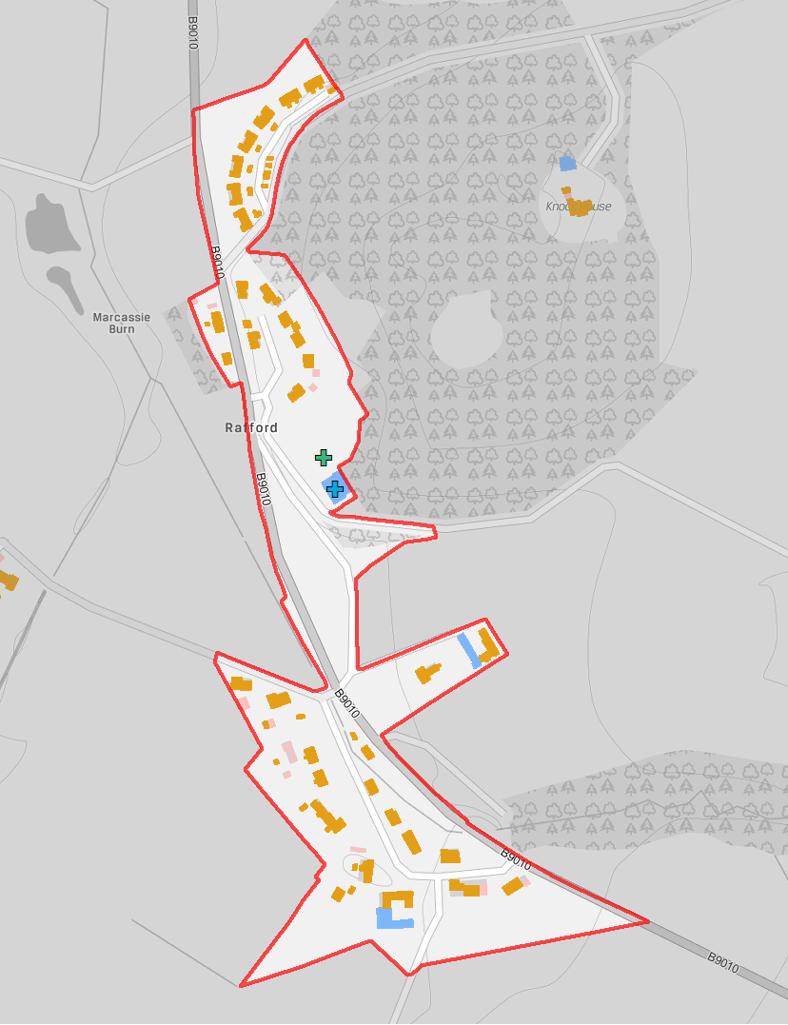
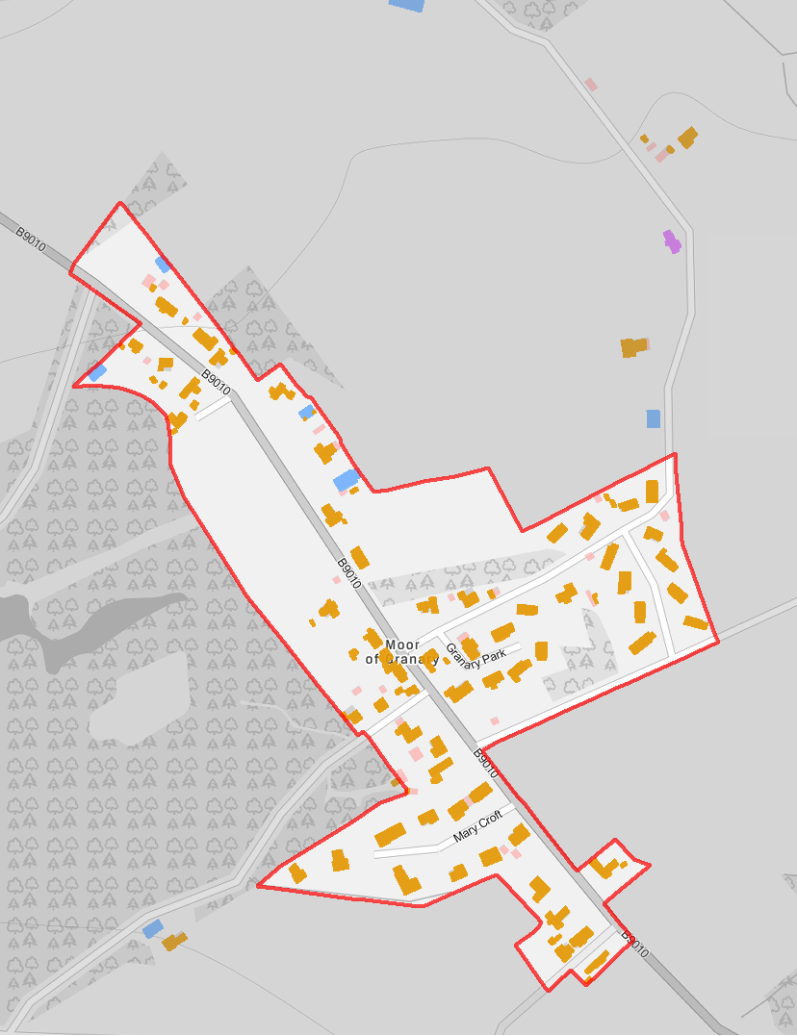
Legend
(! Nursery School
!( Primary School
!( Secondary School
FG Burial Ground FG Crematorium GF Funeral Parlour GF Mission Hall
GF Place Of Worship
Settlement Boundary
Building Use
Commercial Residential Mixed
Rafford
Reproduced from the Ordnance Survey map with the permission of the Controller of Her Majesty's Stationary Office Crown Copyright 2019 The Moray Council 100023422
-
1:5,000 @ A4

Slide 35
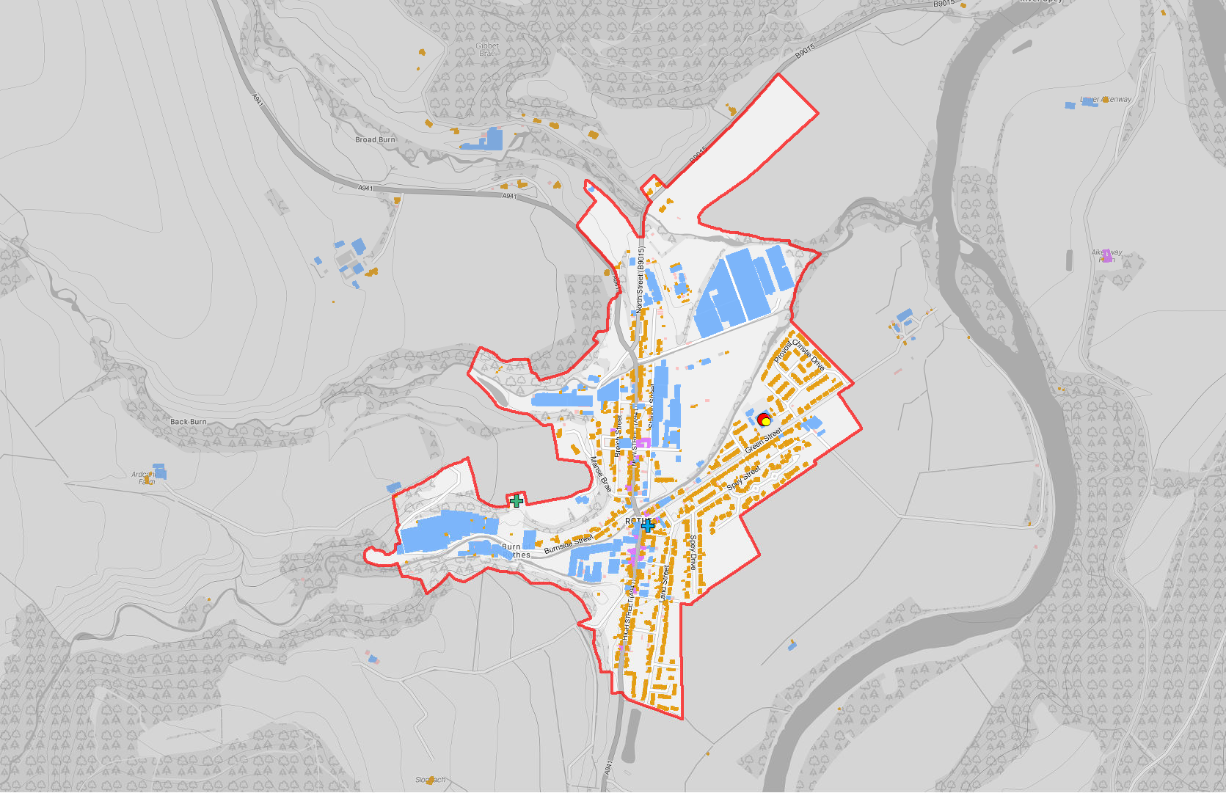
Legend
(! Nursery School
!( Primary School
!( Secondary School
FG Burial Ground FG Crematorium GF Funeral Parlour GF Mission Hall
GF Place Of Worship
Settlement Boundary
Building Use
Commercial Residential Mixed
Rothes
Reproduced from the Ordnance Survey map with the permission of the Controller of Her Majesty's Stationary Office Crown Copyright 2019 The Moray Council 100023422
-
1:12,000 @ A4

Slide 36
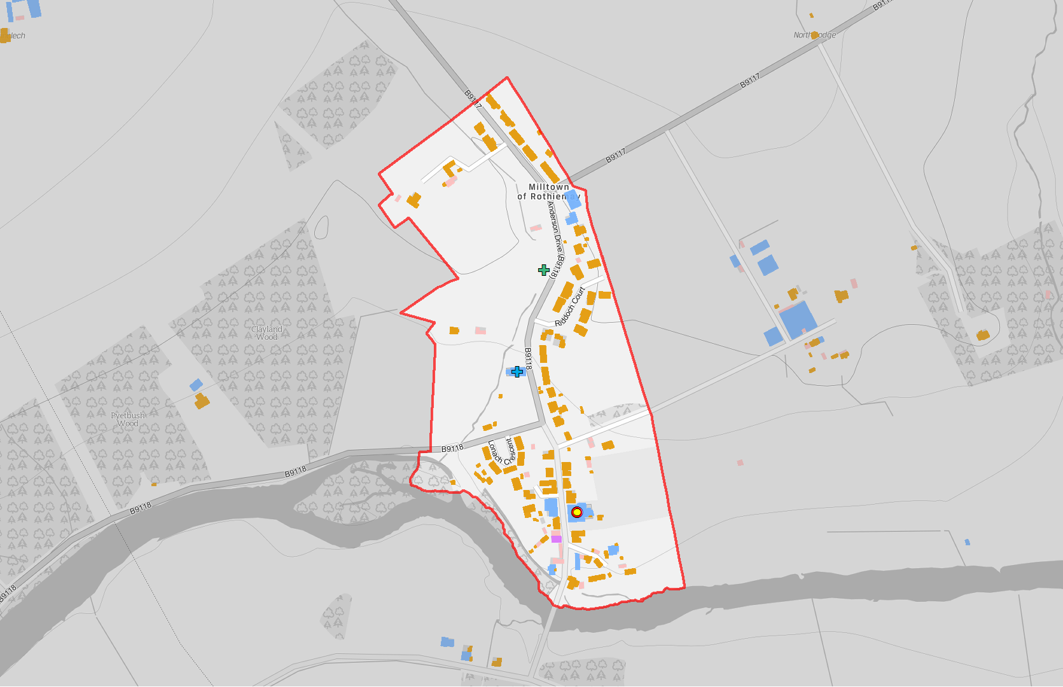
Legend
(! Nursery School
(! Primary School
!( Secondary School
GF Burial Ground GF Crematorium FG Funeral Parlour GF Mission Hall
GF Place Of Worship
Settlement Boundary
Building Use
Commercial Residential Mixed
Rothiemay
Reproduced from the Ordnance Survey map with the permission of the Controller of Her Majesty's Stationary Office Crown Copyright 2019 The Moray Council 100023422
-
1:5,000 @ A4

Slide 37
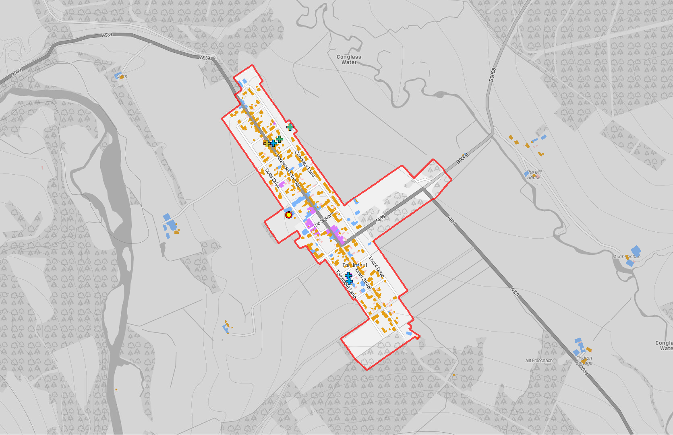
Legend
(! Nursery School
(! Primary School
!( Secondary School
GF Burial Ground GF Crematorium FG Funeral Parlour GF Mission Hall
GF Place Of Worship
Settlement Boundary
Building Use
Commercial Residential Mixed
Tomintoul
Reproduced from the Ordnance Survey map with the permission of the Controller of Her Majesty's Stationary Office Crown Copyright 2019 The Moray Council 100023422
-
1:10,000 @ A4

Slide 38
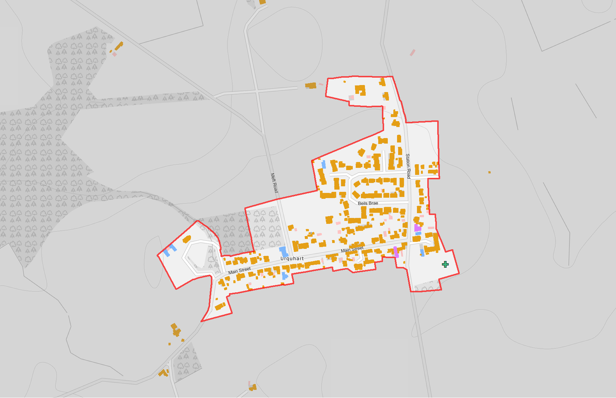
Legend
(! Nursery School
!( Primary School
!( Secondary School
GF Burial Ground FG Crematorium GF Funeral Parlour GF Mission Hall
GF Place Of Worship
Settlement Boundary
Building Use
Commercial Residential Mixed
Urquhart
Reproduced from the Ordnance Survey map with the permission of the Controller of Her Majesty's Stationary Office Crown Copyright 2019 The Moray Council 100023422
-
1:5,000 @ A4

