Slide 1

Child Planning Process

Slide 2

Elements of GIRFEC:
Outline of Provisions
Part 5. Child’s Plan
Requirement
Content
Preparation
Delivery
Management
Assistance in relation to child’s plan

Slide 3
The Child’s Plan requires to contain the following information:
The date of the plan
The child’s full name
Date of birth
Reference number unique to the child
Home address
Name(s) and address(es) or parents/carers
Child’s Named Person and contact details
Lead Professional and contact details
Summary of child’s wellbeing needs and actions required
Summary of wellbeing assessment(s)
Child’s views in relation to wellbeing assessments
Parents’/Carers’ views in relation to wellbeing assessment(s)
Views of other persons who contributed to the wellbeing Plan
Conclusions and recommendations about the assessment(s), conclusions or recommendations
Note of any disagreements about the assessment(s), conclusions or recommendations
The plan should set out in relation to each wellbeing need, action to overtake it, including targeting interventions and timescales
The date of the next scheduled review or the date of the closure of the plan

Slide 4
Moray’s Child’s Plan
Child friendly language
Guidance has been embedded within the plan
SECTIONS A and B form a Record of a Request for Assistance from other professionals
SECTION C – two parts
    Pre-meeting (completed before discussion/meeting)
    Discussion/Meeting
SECTION D – Action Plan
SECTIONS E, F, G – Chronology, CSP etc.

Slide 5
Content (All Sections):
Every box must be filled in
Recorded information should be relevant, necessary, legitimate, appropriate and proportionate
Reference to Information Sharing Guidance
Seek support from Legal Services

Slide 6

Jamie’s Story

Slide 7

Use of plan?
Universal Child’s Plan
Universal Child’s Plan Review
Record of Request for Assistance
Statutory Child’s Plan
Statutory Child’s Plan Review
Statutory Child’s Plan (Compulsory Measures)

Slide 8




Slide 9


Slide 10
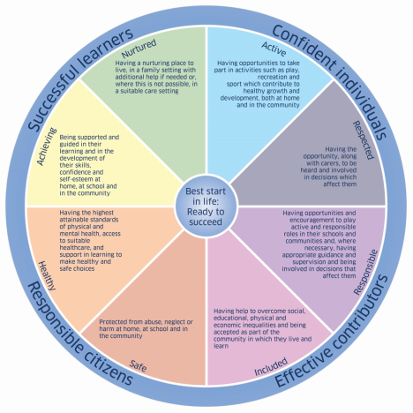

Record of Request for Assistance
SECTION A – Who’s Who?
SECTION B – Why do we need the Plan and who might help?
    Indicate strengths and concerns against the relevant wellbeing indicators
SAFE
HEALTHY
ACHIEVING
NURTURED | 5 GIRFEC QUESTIONS
ACTIVE
RESPECTED
RESPONSIBLE
INCLUDED

Slide 11
Assessment Period
Parts A &B should be sent to the identified agencies
    The Named Person should be notified within 5 working days of the timescale for the assessment.
All assessments MUST include a brief summary and recommendations, and where appropriate a single agency chronology.
All agencies discuss their own assessment/ intervention with the child/family
Named Person reviews all information along with child/family and the other professionals
If a Targeted Intervention is required, the Named Person initiates a Statutory Child’s Plan

Slide 12
Section C(Part1) - What does everyone think?
(pre discussion/meeting)
A summary of assessments
The views of the child and family
Named Person circulates the Child’s Plan to all parties (A, B, C and blank D)
Is a Child Planning meeting required?
    Yes
    No

Slide 13
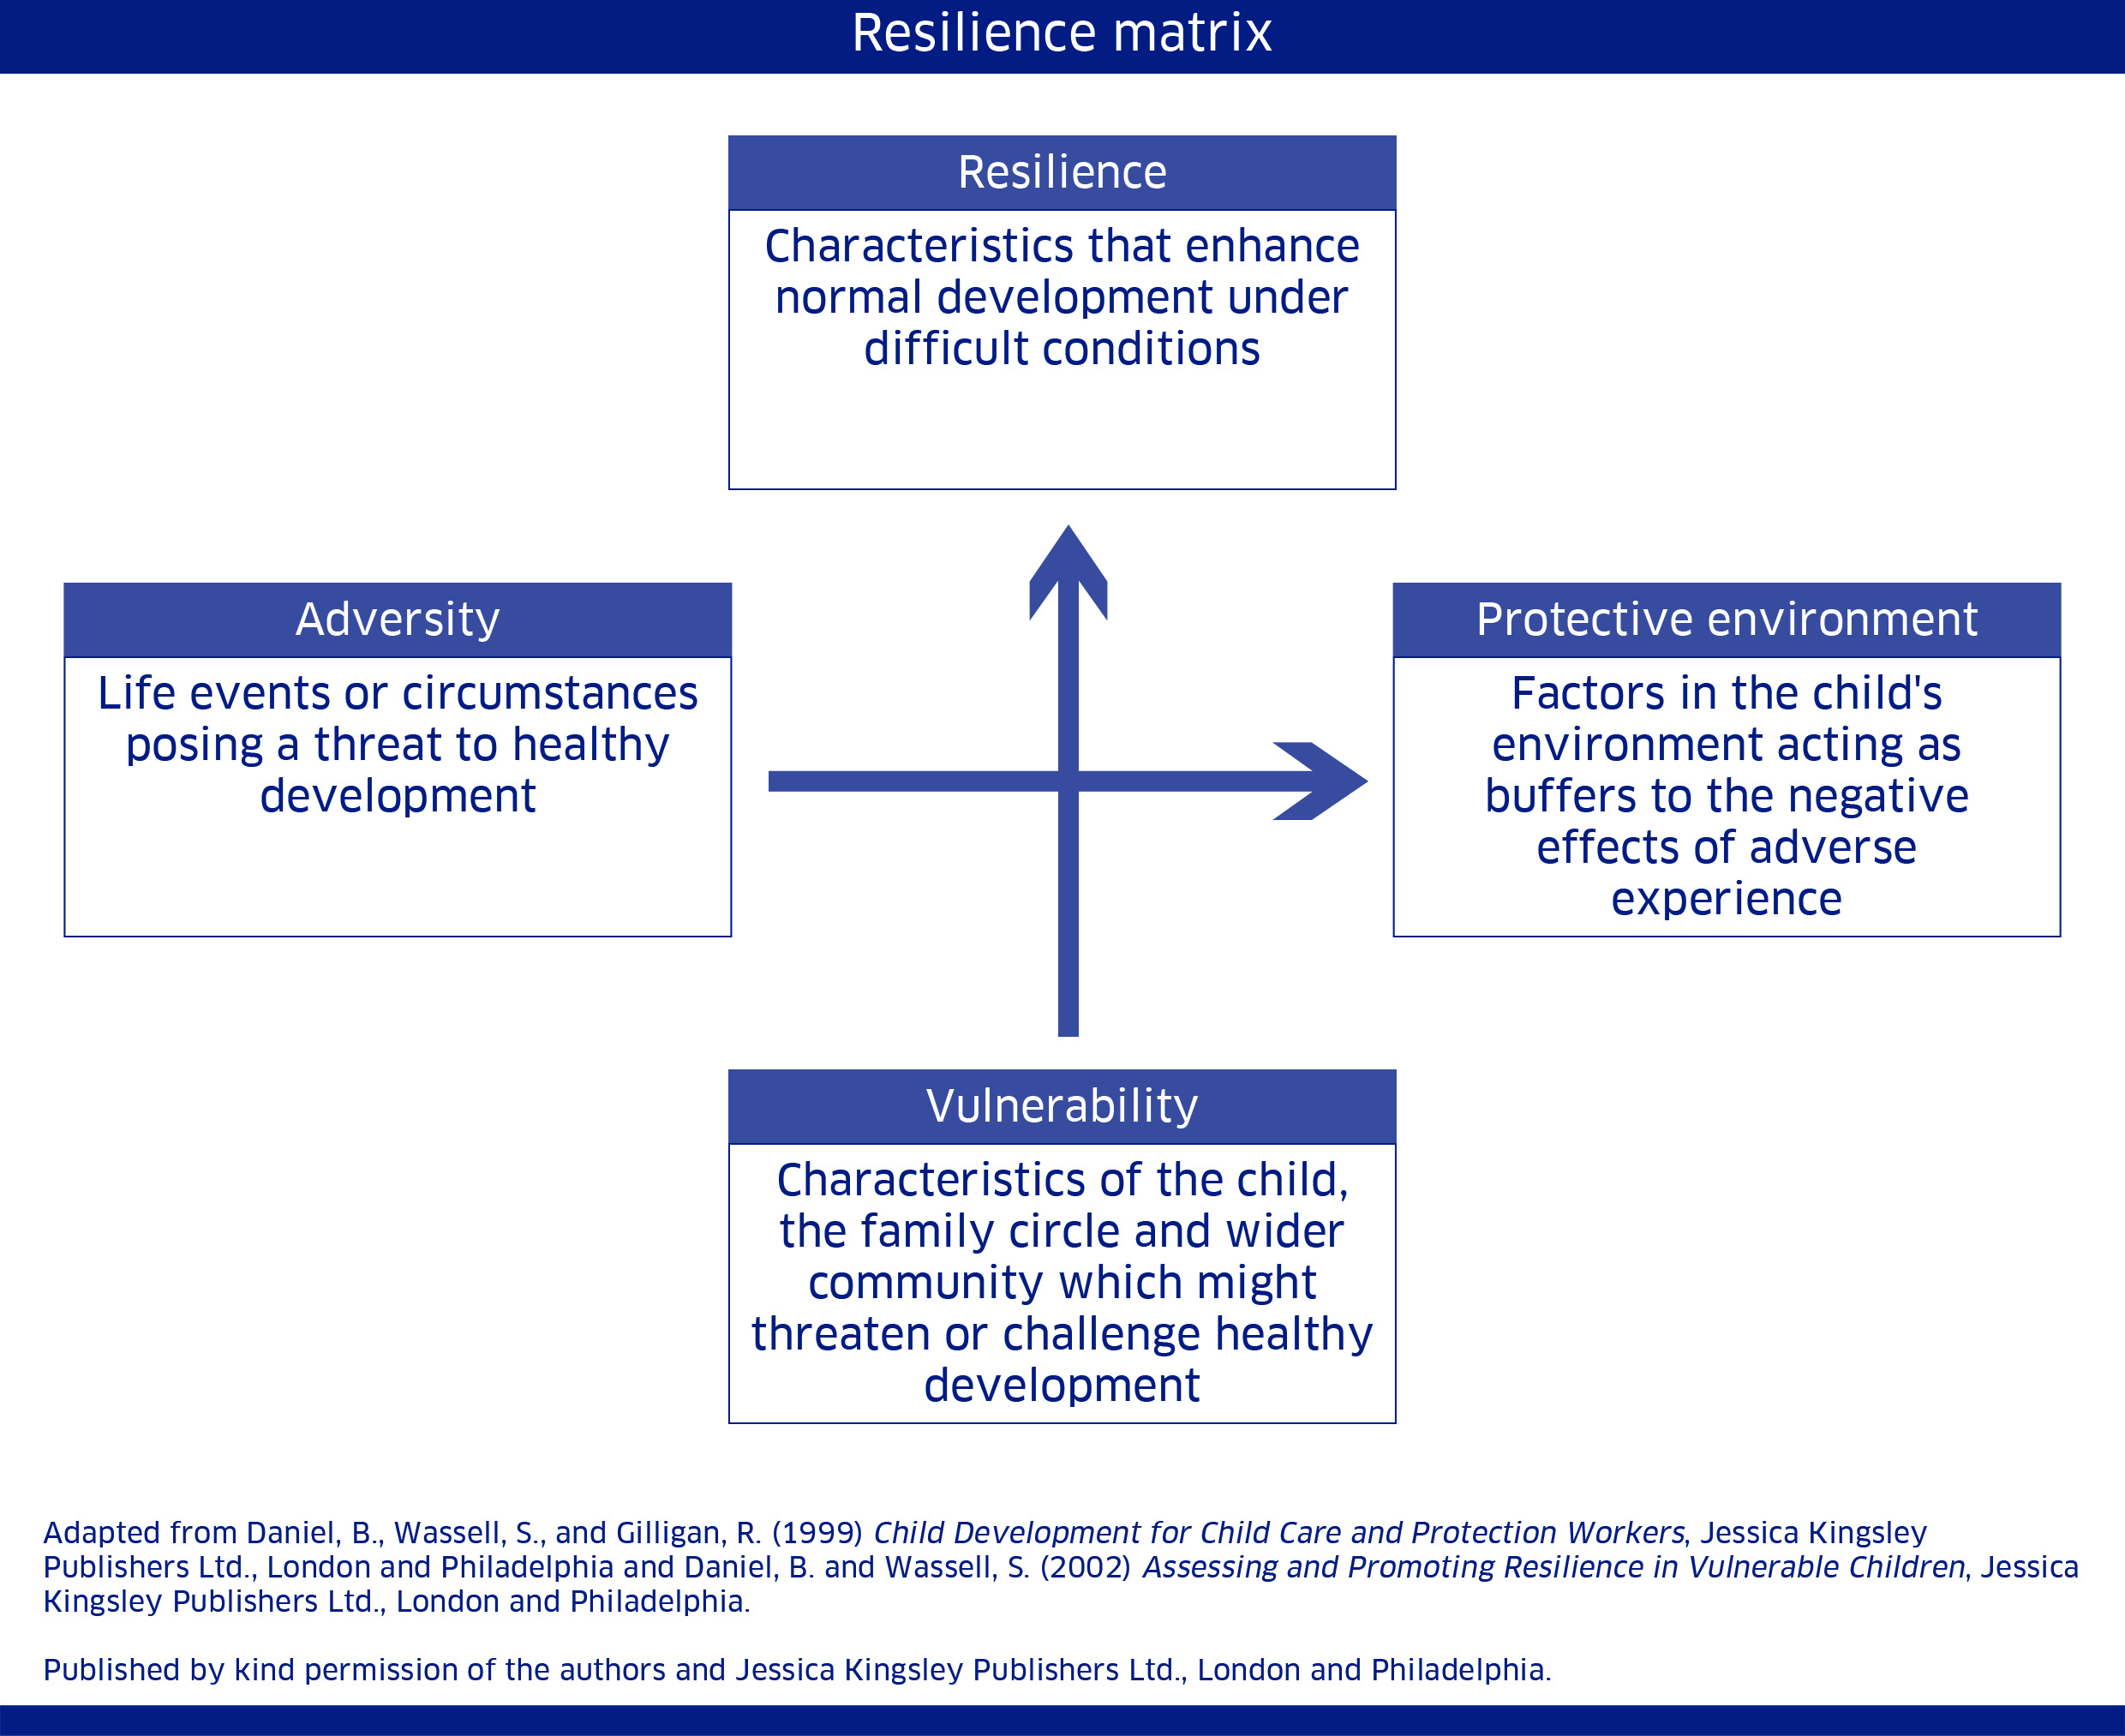
Section C (Part 2) - Analysis (Discussion/Meeting)

Slide 14
Resilience Matrix Exercise
Nominate a Named Person at your group for this exercise
Using the case study you have been given complete the resilience matrix for this young person making sure:
    Each professional has the opportunity to express their opinion
    People’s opinions are reflected and recorded accurately
    Any differences of opinion are recorded
    Your resilience matrix reflects the consensus of the group

Slide 15
ACTION PLAN
What is needed to support this young person and their family (Section D)
Wellbeing Indicator | Outcome identified with the young person/ family | How will we know it has been achieved? (measuring progress) | What needs to happen? (action | By when? | By whom? | Action completed Yes/No/Partial
 | Date outcome achieved?

Slide 16

What is a Chronology?
  “A chronology seeks to provide a clear account of all significant events in a child’s life to date, drawing upon the knowledge and information held by agencies involved with the child and family ”
  (Scottish Govt GIRFEC briefings for practitioners – single and integrated chronologies)
A list in date order of all significant changes and events in a person’s life
Single agency chronology v’s Integrated Chronology

Slide 17
What is a Significant Event?
Any event, and/or concern, which has a significantly positive or negative impact on the child or young person.
It is NOT a record of an agency’s involvement with a child/young person.
An historical event may not be significant at the time
Professional Judgement

Slide 18
HEALTH – SIGNIFICANT EVENTS
CHECKLIST
Positive or negative changes in health related problems in relation to the child or the parents/carers, such as disability, substance related issues, mental health issues etc.
Changes to family care structure
Changes to child’s physical or emotional wellbeing
Changes in family circumstances
Referrals to paediatric services, therapy services
Attendance at A & E
Incidences of hospital admissions
Changes in disability
Immunisations/screening
Formal Health assessments
Change to health visitor
Missed appointments without acceptable reasons
Threats or actual incidents of violence to staff
Any other concerns or POSITIVE IMPROVEMENTS
Significant home visits

Slide 19

EDUCATION – SIGNIFICANT EVENTS
CHECKLIST
Positive or negative changes in family structure
Positive or negative changes in family circumstances
Physical and mental health and wellbeing of child, parents/carers
Positive or negative changes in performance, attainment or achievement
Identification of ASN within Staged Intervention Process
Positive or negative changes in attendance
Positive or negative changes in parental presence, engagement or support with the child’s learning
Episodes of exclusion/re-integration
Significant periods of absence e.g. illness, pregnancy, truancy
Social inclusion within the school setting including evidence of bullying or positive support networks
Decision to initiate a wellbeing assessment/child planning process
Change of Named Person or other key member of staff from child’s school
Change of school
Any threats or actual incidents of violence to staff by parents or child
Any other relevant concerns or POSITIVE IMPROVEMENTS

Slide 20
Summary of the Core Elements of a Chronology
Key dates of birth, life events, moves etc.
Transitions, life changes
Key professional interventions, reviews, hearings etc.
Facts
Brief note of an event and reason for its significance
Source of information
The actions which were taken, including no action

Slide 21
Developing an Integrated Chronology
Single agency provides a brief description and summarised account of events in date order.
Where there is Targeted Intervention and requirement for a Statutory Child’s Plan then the Lead Professional would have responsibility to collate the integrated chronology.
The Team around the Child (TAC) should provide information from their single agency chronology to the Lead Professional. This is then shared with TAC, child/young person and families.
If the child/young person has been referred to Social Work then it will be the Social Worker’s responsibility to ensure they get single agency chronologies from the TAC to lead in completing the integrated chronology.

Slide 22
Multi-agency Template
FAMILY / INDIVIDUAL
Source – H = health, E = education, P = police, SW – social work, F- family, O – other ( please detail)
DATE OF EVENT | DETAIL OF SIGNIFICANT EVENT | OUTCOME | SOURCE

Slide 23


Slide 24

LEAD PROFESSIONAL – How do we choose?
One or more Targeted Interventions
It is the person best placed to co-ordinate the help agreed within the Child’s Action Plan
This may be influenced by:
    The child and the family’s views
    The kind of help which the family requires
    Previous contact or a good relationship with the child
    Any statutory responsibility to co-ordinate work with the child/and or family.

Slide 25



Slide 26
Skills, Knowledge and Understanding
Main point of contact
Promote teamwork
Coordinate an assessment of risk and need
Coordinate the updating of an integrated chronology
Action plan is implemented, reviewed and updated
Familiar with the remit of other agencies
Coordinate workers who have specific roles – avoid overlap and inconsistency
Key transition points
Child’s plan is accurate and up to date
Regularly liaise with the Named Person

Slide 27
Lead Professional
Do all the work
Chase up (pursue other) assessment team members for contribution
Take full responsibility of the assessment or action plan, as this is a multi-professional responsibility
Take responsibility or be accountable for the actions of others

Slide 28
LEAD PROFESSIONAL EXERCISE
Table Exercise – Nominate a Lead Professional for this exercise
Consider all of the information about Jamie as a group and discuss who you might think would be best placed to take the role of Lead professional and why. Record any agreements/disagreements
Repeat the exercise with the other case studies.

Slide 29
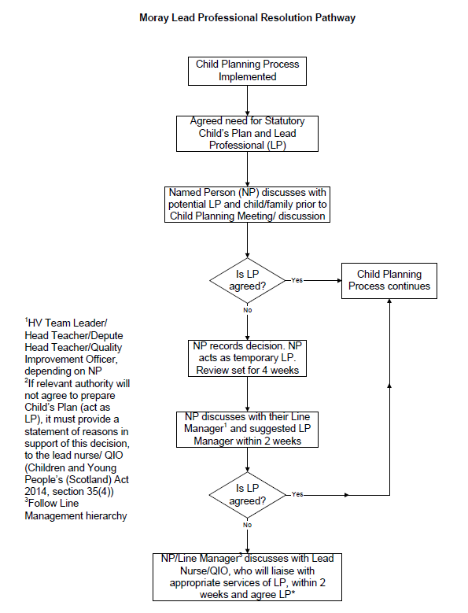

Slide 30
Reviewing of the Child’s Plan
Professionals send summary of assessment/intervention/involvement to LP
Initial Child Plan Meeting – 1 week
Future Review meetings – 2 weeks or an agreed date
LP sends updated Sections A, B, C and D
Date and time of next review – 12 weeks/6 weeks (LAC)
As required but at least once per year/transition
Early review
Child’s Plan closed

