Slide 1

WELLBEING

Slide 2


Consideration of Wellbeing
Something that a wide range of practitioners do daily
Structured or unstructured
Often a straightforward and immediate response as part of routine practice
May lead to identification of a wellbeing need or to the need for a more structured assessment

Slide 3
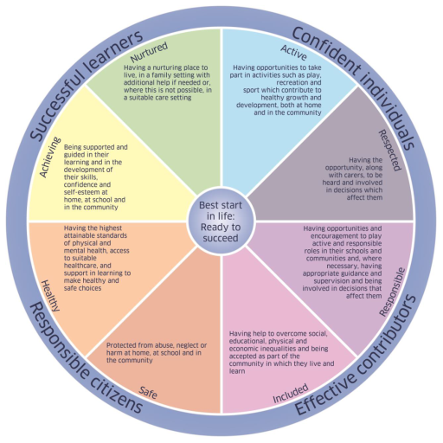

GIRFEC Wellbeing Indicators
(now in statute)
Safe
Healthy
Achieving
Nurtured
Active
Respected
Responsible
Included

Slide 4
5 GIRFEC Questions when a wellbeing need/ concern is identified
What is getting in the way of this child's or young person's wellbeing?
Do I have all the information I need to help this child or young person?
What can I do now to help this child or young person?
What can my service do to help this child or young person?
What additional help, if any, may be needed from others?
What are the child or young person’s views?

Slide 5

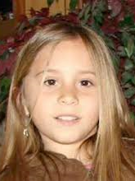

Slide 6
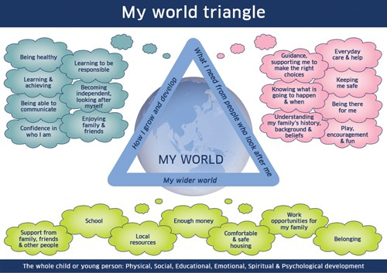
My World Triangle
The whole Child or Young Person: Physical, Social, Educational, Emotional, Spiritual and Psychological development

Slide 7
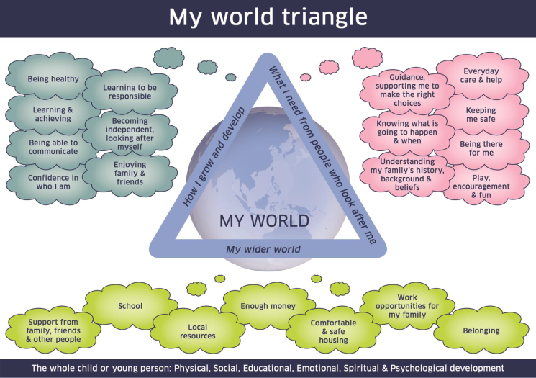

Slide 8
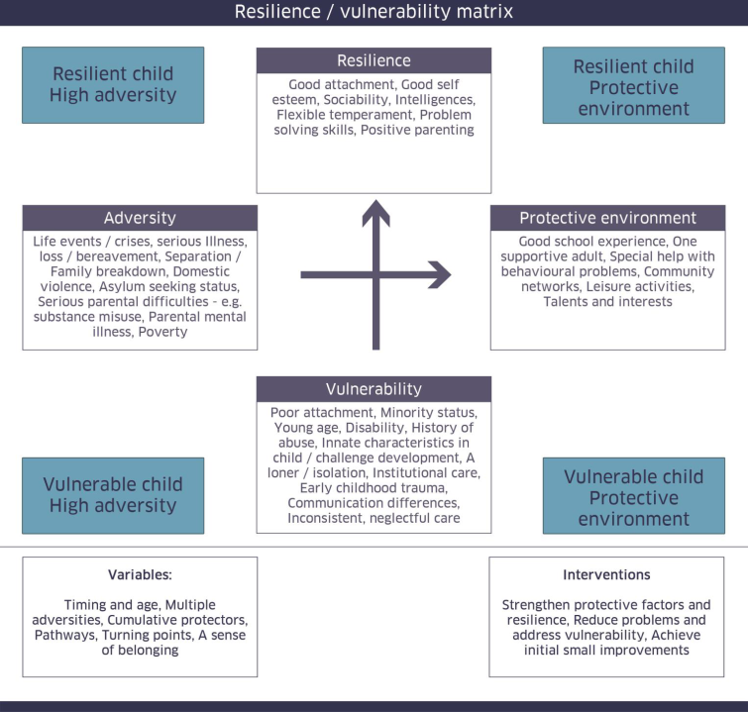

Slide 9
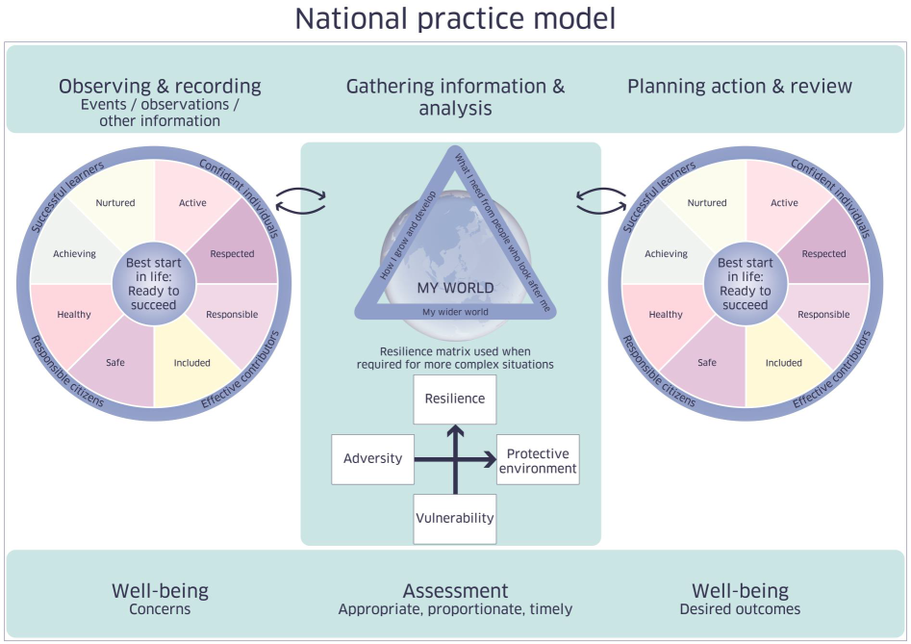

Slide 10
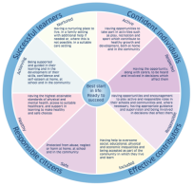
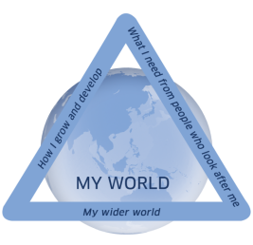
Wellbeing is always INDIVIDUALISED
Wellbeing
Resources
Resilience
Protective Environment
Challenges
Adversity
Vulnerability
The balance point between an individual’s resource pool and the challenges faced

